Slide 1

COMS W4111 - Introduction to Databases
(Module II) DBMS Architecture and Implementation: Disks, I/O, Indexes
Donald F. Ferguson (dff@cs.columbia.edu)
Lecture 9: Disks, I/O, Indexes

Slide 2

Course Schedule and Assignments Updates
2 | Introduction to Databases (F20): Lecture 8: Disks, I/O, Indexes

Slide 3
Course Focus
We held a database teaching faculty meeting on 22-OCT.
We are trying to make the various sections of W4111 more consistent.
I am making two minor changes, which I believe will improve the course for you.
Reduce lecture time for Module II – DBMS architecture and implementation.
Module II covers how to implement a DBMS. The other modules cover how to use databases to solve problem.
4112 covers “how to implement a DBMS.”
”How to implement a DBMS is primarily relevant to CS majors, and not all tracks.
Evolve HW4 (and HW 5) into track specific projects. Use all of the Module I, III and IV concepts to solve a more realistic scenarios.

Slide 4
Course Schedule (Tentative)
Date | Topics | Assignments
30-OCT | Module II: I/O subsystem, I/O optimization, indexes.
6-NOV | Module II: Query optimization, transactions, recovery. Module III: NoSQL concepts, BASE, graph database (1)
13-NOV | Module III: Graph databases continued. Module III: Document databases.
20-NOV | Module III: Key-value databases. Module III: An example of a combined relational, NoSQL application.
27-NOV | Thanksgiving Break
4-DEC | Module IV: Normalization/De-Normalization Module IV: Big data (succinctly), applying database design
11-DEC | Module IV: Data analysis, decision support, OLAP Miscellaneous topics.
18-DEC | Final exam due.
HW 3 Written
10 pts.
HW 4 (Project) Part I
10 pts.
HW 4 (Project) Part 2
10 pts.
5 pts. Extra Credit.
30 pts.
Final
Extra Credit

Slide 5
Module II – DBMS Architecture and Implementation
Overview and Reminder
5 | Introduction to Databases (F20): Lecture 8: Disks, I/O, Indexes

Slide 6
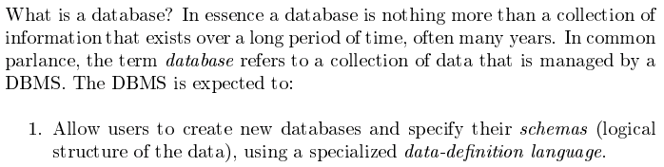
Database Management System Reminder
Covered for the relational model.
Database Systems: The Complete Book (2nd Edition) by Hector Garcia-Molina (Author), Jeffrey D. Ullman (Author), Jennifer Widom (Author)
6 | Introduction to Databases (F20): Lecture 8: Disks, I/O, Indexes © Donald F. Ferguson, 2020

Slide 7
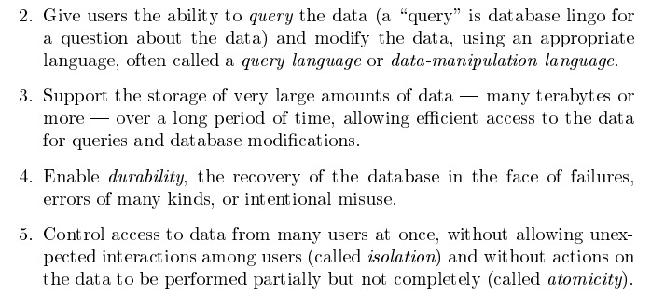
Database Management System Reminder
Focus for next part of course.
Database Systems: The Complete Book (2nd Edition) by Hector Garcia-Molina (Author), Jeffrey D. Ullman (Author), Jennifer Widom (Author)

Slide 8
Purpose of Database Systems
In the early days, database applications were built directly on top of file systems, which leads to:
Data redundancy and inconsistency: data is stored in multiple file formats resulting induplication of information in different files
Difficulty in accessing data
Need to write a new program to carry out each new task
Data isolation
Multiple files and formats
Integrity problems
Integrity constraints (e.g., account balance > 0) become “buried” in program code rather than being stated explicitly
Hard to add new constraints or change existing ones
Notes:
8

Slide 9
Purpose of Database Systems (Cont.)
Atomicity of updates
Failures may leave database in an inconsistent state with partial updates carried out
Example: Transfer of funds from one account to another should either complete or not happen at all
Concurrent access by multiple users
Concurrent access needed for performance
Uncontrolled concurrent accesses can lead to inconsistencies
Ex: Two people reading a balance (say 100) and updating it by withdrawing money (say 50 each) at the same time
Security problems
Hard to provide user access to some, but not all, data
Database systems offer solutions to all the above problems
In Module I, we explored how users interact with the (some) of the functions through DDL and DML. In this module, we will explore how DBMS implement the capabilities “under the covers.”
Notes:
9

Slide 10
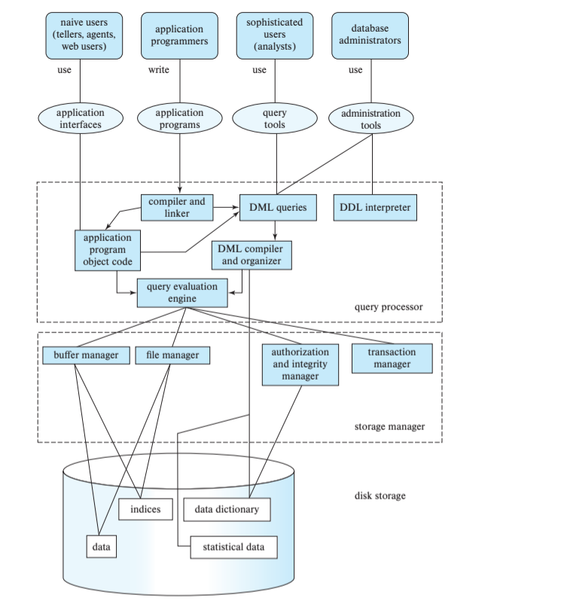
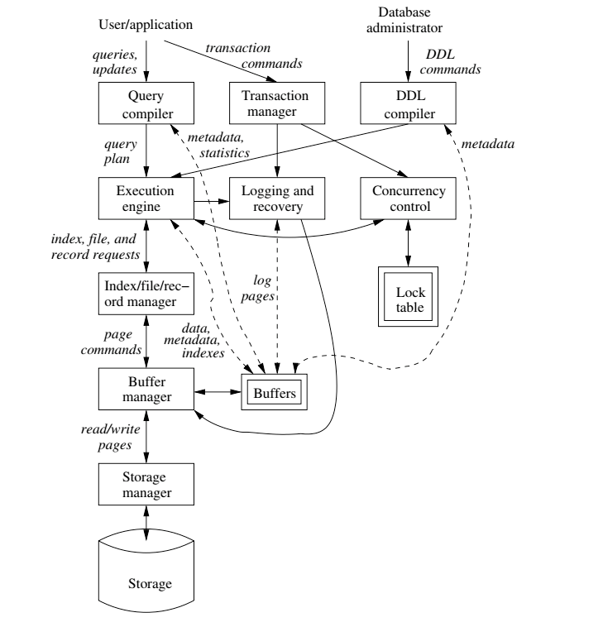
DBMS Subsystems
10 | Introduction to Databases (F20): Lecture 8: Disks, I/O, Indexes © Donald F. Ferguson, 2020

Slide 11
Disks, I/O, Indexes (Database Systems Concepts, V7, Ch. 12)
11 | Introduction to Databases (F20): Lecture 8: Disks, I/O, Indexes

Slide 12
Disks as Far as the Eye Can See
12 | Introduction to Databases (F20): Lecture 8: Disks, I/O, Indexes © Donald F. Ferguson, 2018

Slide 13

Data Management
Find things quickly.
Access things quickly.
Load/save things quickly.
Database Systems: The Complete Book (2nd Edition) by Hector Garcia-Molina (Author), Jeffrey D. Ullman (Author), Jennifer Widom (Author)

Slide 14
Classification of Physical Storage Media
Can differentiate storage into:
volatile storage: loses contents when power is switched off
non-volatile storage:
Contents persist even when power is switched off.
Includes secondary and tertiary storage, as well as batter-backed up main-memory.
Factors affecting choice of storage media include
Speed with which data can be accessed
Cost per unit of data
Reliability

Slide 15
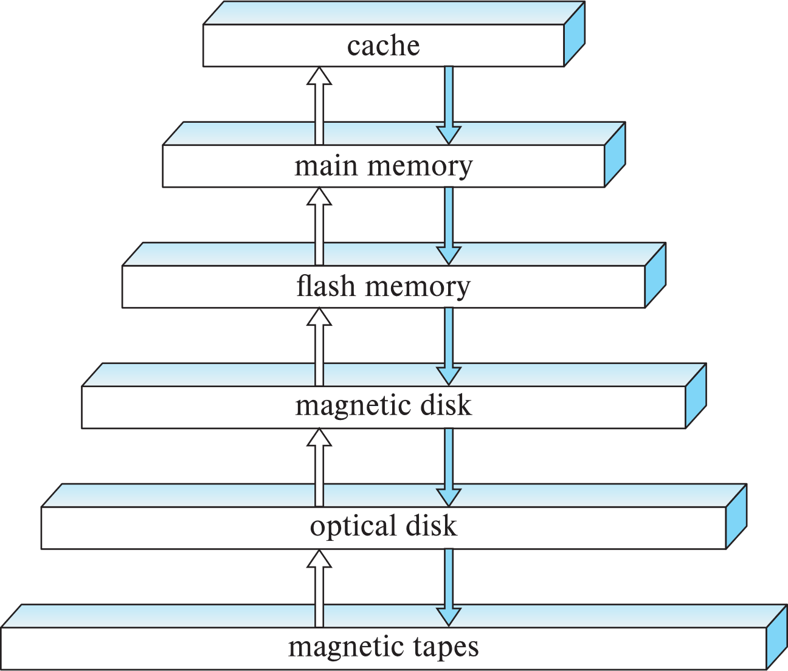
Storage Hierarchy

Slide 16
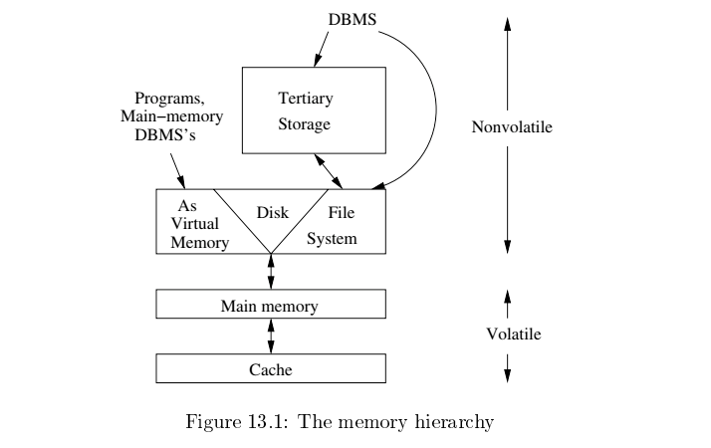
Memory Hierarchy
Slower
Cheaper
Unlimited
Faster
More expensive
Limited

Slide 17
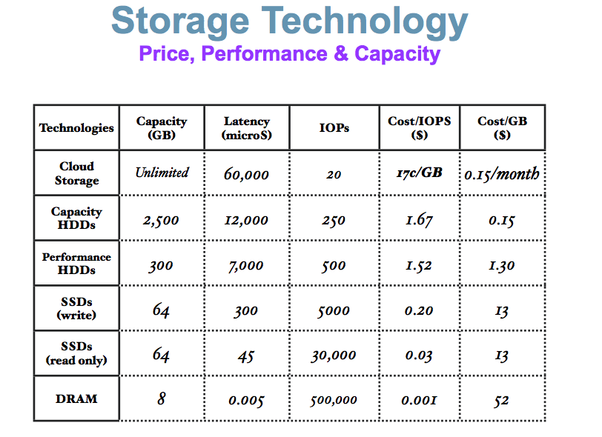
Memory Hierarchy (Very Old Numbers – Still Directionally Valid)
These numbers are ancient.
Looking for more modern numbers.
But, does give an idea of
Price
Performance
The general observation is that
Performance goes up 10X/level.
Price goes up 10x per level.
Note: One major change is improved price performance of SDD relative to HDD for large data.

Slide 18
Storage Hierarchy (Cont.)
primary storage: Fastest media but volatile (cache, main memory).
secondary storage: next level in hierarchy, non-volatile, moderately fast access time
Also called on-line storage
E.g., flash memory, magnetic disks
tertiary storage: lowest level in hierarchy, non-volatile, slow access time
also called off-line storage and used for archival storage
e.g., magnetic tape, optical storage
Magnetic tape
Sequential access, 1 to 12 TB capacity
A few drives with many tapes
Juke boxes with petabytes (1000’s of TB) of storage

Slide 19
Storage Interfaces
Disk interface standards families
SATA (Serial ATA)
SATA 3 supports data transfer speeds of up to 6 gigabits/sec
SAS (Serial Attached SCSI)
SAS Version 3 supports 12 gigabits/sec
NVMe (Non-Volatile Memory Express) interface
Works with PCIe connectors to support lower latency and higher transfer rates
Supports data transfer rates of up to 24 gigabits/sec
Disks usually connected directly to computer system
In Storage Area Networks (SAN), a large number of disks are connected by a high-speed network to a number of servers
In Network Attached Storage (NAS) networked storage provides a file system interface using networked file system protocol, instead of providing a disk system interface

Slide 20
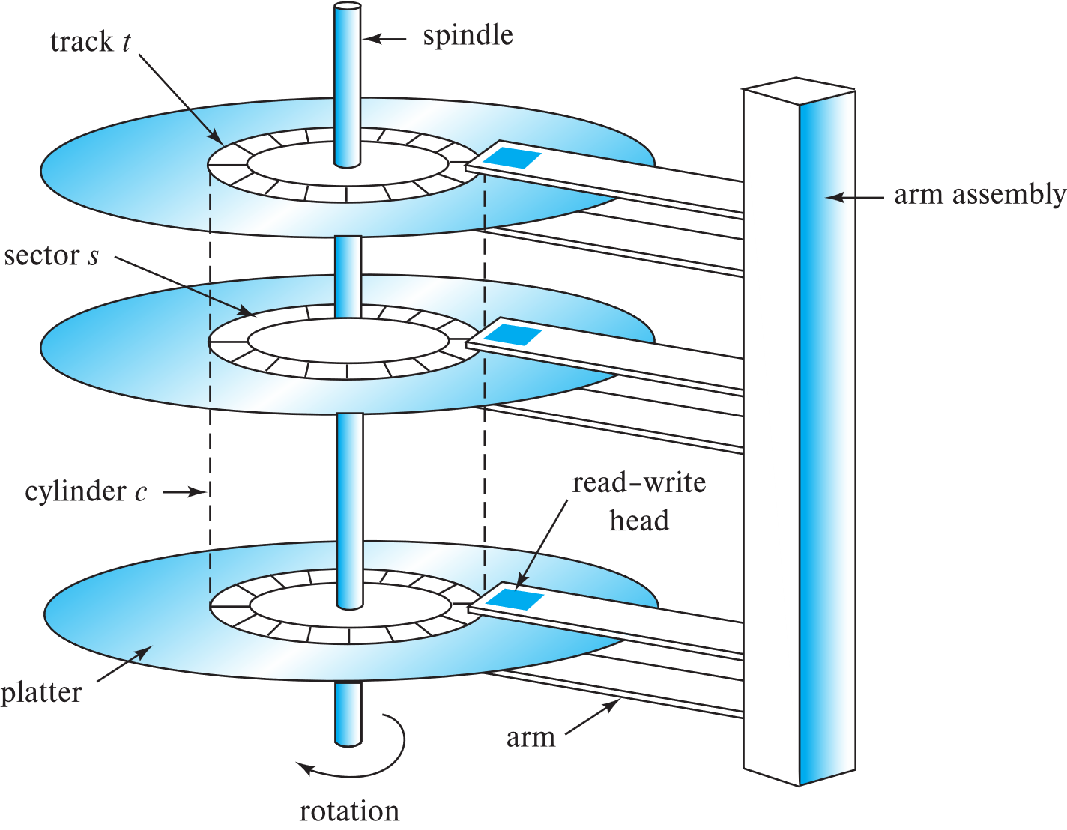
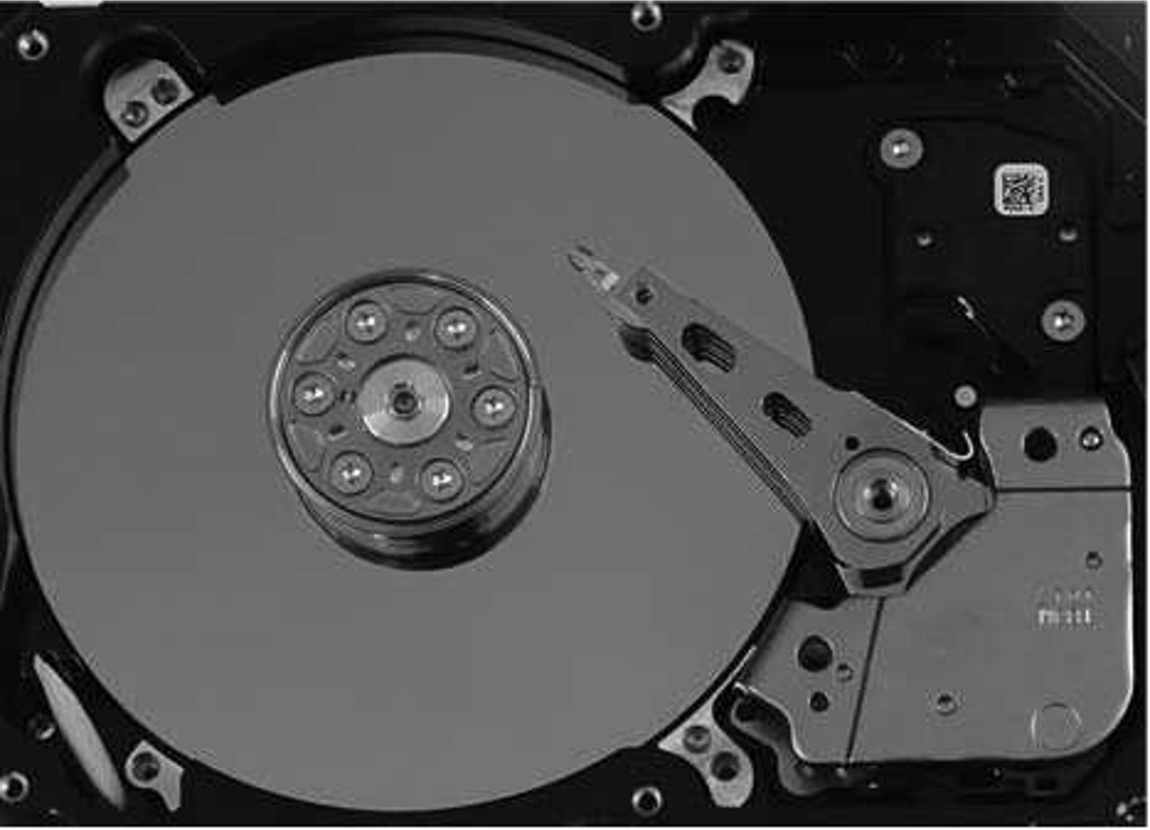
Magnetic Hard Disk Mechanism
Schematic diagram of magnetic disk drive
Photo of magnetic disk drive

Slide 21
Hard Disk Drive

Slide 22
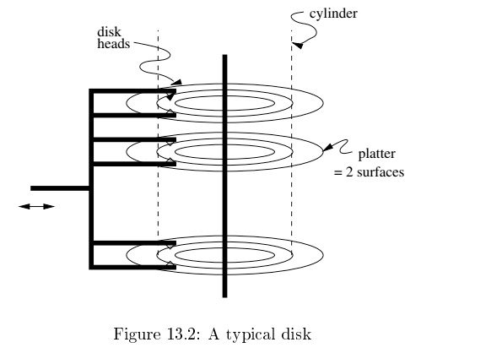
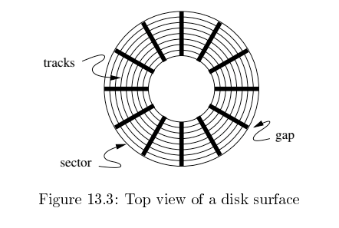
Disk Configuration
Components of disk I/O delay
Seek: Move head to cylinder/track.
Rotation: Wait for sector to get under head.
Transfer: Move data from disk to memory.
Database Systems: The Complete Book (2nd Edition) by Hector Garcia-Molina (Author), Jeffrey D. Ullman (Author), Jennifer Widom (Author)

Slide 23
Hard Disk versus Solid State Disk
Hard
Disk
Drive
Solid
State
Drive

Slide 24
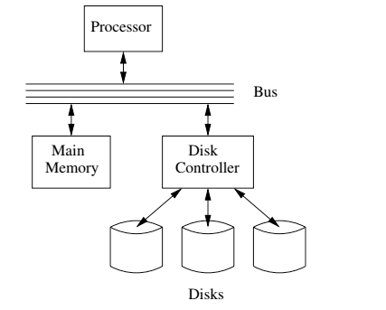
I/O Architecture
Large scale environments
The bus-controller connection is over some kind of network.
The disk controller is at the disks, and basically a “computer” with SW.
Network is either
Standard communication network, or
Highly optimized I/O network.
How we normally think of disks and I/O.

Slide 25
Magnetic Disks
Read-write head
Surface of platter divided into circular tracks
Over 50K-100K tracks per platter on typical hard disks
Each track is divided into sectors.
A sector is the smallest unit of data that can be read or written.
Sector size typically 512 bytes
Typical sectors per track: 500 to 1000 (on inner tracks) to 1000 to 2000 (on outer tracks)
To read/write a sector
disk arm swings to position head on right track
platter spins continually; data is read/written as sector passes under head
Head-disk assemblies
multiple disk platters on a single spindle (1 to 5 usually)
one head per platter, mounted on a common arm.
Cylinder i consists of i^{th} track of all the platters
Notes:
Mention: checksums, bad sector remapping

Slide 26
Magnetic Disks (Cont.)
Disk controller – interfaces between the computer system and the disk drive hardware.
accepts high-level commands to read or write a sector
initiates actions such as moving the disk arm to the right track and actually reading or writing the data
Computes and attaches checksums to each sector to verify that data is read back correctly
If data is corrupted, with very high probability stored checksum won’t match recomputed checksum
Ensures successful writing by reading back sector after writing it
Performs remapping of bad sectors

Slide 27
Performance Measures of Disks
Access time – the time it takes from when a read or write request is issued to when data transfer begins. Consists of:
Seek time – time it takes to reposition the arm over the correct track.
Average seek time is 1/2 the worst case seek time.
Would be 1/3 if all tracks had the same number of sectors, and we ignore the time to start and stop arm movement
4 to 10 milliseconds on typical disks
Rotational latency – time it takes for the sector to be accessed to appear under the head.
4 to 11 milliseconds on typical disks (5400 to 15000 r.p.m.)
Average latency is 1/2 of the above latency.
Overall latency is 5 to 20 msec depending on disk model
Data-transfer rate – the rate at which data can be retrieved from or stored to the disk.
25 to 200 MB per second max rate, lower for inner tracks

Slide 28
Performance Measures (Cont.)
Disk block is a logical unit for storage allocation and retrieval
4 to 16 kilobytes typically
Smaller blocks: more transfers from disk
Larger blocks: more space wasted due to partially filled blocks
Sequential access pattern
Successive requests are for successive disk blocks
Disk seek required only for first block
Random access pattern
Successive requests are for blocks that can be anywhere on disk
Each access requires a seek
Transfer rates are low since a lot of time is wasted in seeks
I/O operations per second (IOPS)
Number of random block reads that a disk can support per second
50 to 200 IOPS on current generation magnetic disks

Slide 29
Performance Measures (Cont.)
Mean time to failure (MTTF) – the average time the disk is expected to run continuously without any failure.
Typically 3 to 5 years
Probability of failure of new disks is quite low, corresponding to a “theoretical MTTF” of 500,000 to 1,200,000 hours for a new disk
E.g., an MTTF of 1,200,000 hours for a new disk means that given 1000 relatively new disks, on an average one will fail every 1200 hours
MTTF decreases as disk ages

Slide 30
Flash Storage
NOR flash vs NAND flash
NAND flash
used widely for storage, cheaper than NOR flash
requires page-at-a-time read (page: 512 bytes to 4 KB)
20 to 100 microseconds for a page read
Not much difference between sequential and random read
Page can only be written once
Must be erased to allow rewrite
Solid state disks
Use standard block-oriented disk interfaces, but store data on multiple flash storage devices internally
Transfer rate of up to 500 MB/sec using SATA, and up to 3 GB/sec using NVMe PCIe

Slide 31
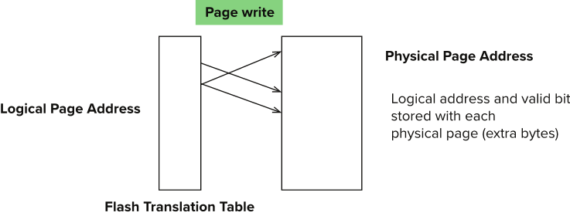
Flash Storage (Cont.)
Erase happens in units of erase block
Takes 2 to 5 millisecs
Erase block typically 256 KB to 1 MB (128 to 256 pages)
Remapping of logical page addresses to physical page addresses avoids waiting for erase
Flash translation table tracks mapping
also stored in a label field of flash page
remapping carried out by flash translation layer
After 100,000 to 1,000,000 erases, erase block becomes unreliable and cannot be used
wear leveling
Notes:
Where is FTL stored? How is it reconstructed on system startup?
How to track number of erases per block (extra storage per block)

Slide 32
SSD Performance Metrics
Random reads/writes per second
Typical 4 KB reads: 10,000 reads per second (10,000 IOPS)
Typical 4KB writes: 40,000 IOPS
SSDs support parallel reads
Typical 4KB reads:
100,000 IOPS with 32 requests in parallel (QD-32) on SATA
350,000 IOPS with QD-32 on NVMe PCIe
Typical 4KB writes:
100,000 IOPS with QD-32, even higher on some models
Data transfer rate for sequential reads/writes
400 MB/sec for SATA3, 2 to 3 GB/sec using NVMe PCIe
Hybrid disks: combine small amount of flash cache with larger magnetic disk

Slide 33
Storage Class Memory
3D-XPoint memory technology pioneered by Intel
Available as Intel Optane
SSD interface shipped from 2017
Allows lower latency than flash SSDs
Non-volatile memory interface announced in 2018
Supports direct access to words, at speeds comparable to main-memory speeds

Slide 34
I/O Architecture
Redundant Array of Independent Disks (RAID)

Slide 35
RAID (https://en.wikipedia.org/wiki/RAID)
“RAID (redundant array of independent disks) is a data storage virtualization technology that combines multiple physical disk drive components into a single logical unit for the purposes of data redundancy, performance improvement, or both. (…)
RAID 0 consists of striping, without mirroring or parity. (…)
RAID 1 consists of data mirroring, without parity or striping. (…)
RAID 2 consists of bit-level striping with dedicated Hamming-code parity. (…)
RAID 3 consists of byte-level striping with dedicated parity. (…)
RAID 4 consists of block-level striping with dedicated parity. (…)
RAID 5 consists of block-level striping with distributed parity. (…)
RAID 6 consists of block-level striping with double distributed parity. (…)
Nested RAID
RAID 0+1: creates two stripes and mirrors them. (…)
RAID 1+0: creates a striped set from a series of mirrored drives. (…)
JBOD RAID N+N: With JBOD (just a bunch of disks), (…)”

Slide 36
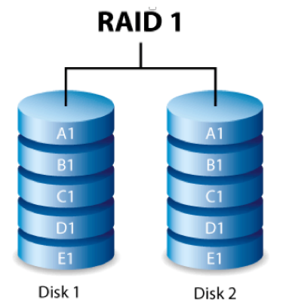
RAID-0 and RAID-1
Two physical disks make one single, logical fast disk
Two physical disks make one single, logical reliable disk
Single “Fast” Disk
Single “Reliable” Disk

Slide 37
Mixed RAID Modes
Stripe
And
Mirror

Slide 38
RAID-5
One Big Logical Disk
Improved performance through parallelism
Rotation/seek
Transfer
Availability uses parity blocks
Suppose I have 4 different data blocks on the logical drive A: A1, A2, A3, A4.
Parity function: Ap = P(A1,A2,A3,A4)
Recovery function: A2=R(Ap,A1,A3,A4)
During normal operations:
Read processing simply retrieves block.
Write processing of A2 updates A2 and Ap
If an individual disk fails, the RAID
Read
Continues to function for reads on non-missing blocks.
Implements read on missing block by recalculating value.
Write
Updates block and parity block for non-missing blocks.
Computes missing block, and calculates parity based on old and new value.
Over time
“Hot Swap” the failed disk.
Rebuild the missing data from values and parity.
Is actually 5 smaller “logical” disks.
A
B
C
D
E
Logical disk data spread over 5 physical disks.

Slide 39
Very Simple Parity Example
Even-Odd Parity
b[i] is an array of bits (0 or 1)
P(b[i]) =
0 is an even number of bits = 1. {P([0,1,1,0,1,1])= 0
1 if an odd number of bits = 1. {P(0,0,1,0,1,1]= 1
Given an array with one missing bit and the parity bit, I can re-compute the missing bit.
Case 1: [0,?,1,0,1,1] has P=0. There must be an EVEN number of ones and ?=1.
Case 2: [0,?,1,0,1,1] has P=1. There must be an ODD number of ones and ?=0.
Block Parity applies this to a set of blocks bitwise
A1=[0,1,0,0,1,1]
A2=[1,1,1,0,0,0]
A3=[0,0,0,1,0,1]
Pa=[1,0,1,1,1,0]
➔
If I am missing a block and have the parity block, I can re-compute the missing block bitwise from remaining blocks and parity block.

Slide 40
RAID
RAID: Redundant Arrays of Independent Disks
disk organization techniques that manage a large numbers of disks, providing a view of a single disk of
high capacity and high speed by using multiple disks in parallel,
high reliability by storing data redundantly, so that data can be recovered even if a disk fails
The chance that some disk out of a set of N disks will fail is much higher than the chance that a specific single disk will fail.
E.g., a system with 100 disks, each with MTTF of 100,000 hours (approx. 11 years), will have a system MTTF of 1000 hours (approx. 41 days)
Techniques for using redundancy to avoid data loss are critical with large numbers of disks

Slide 41
Improvement of Reliability via Redundancy
Redundancy – store extra information that can be used to rebuild information lost in a disk failure
E.g., Mirroring (or shadowing)
Duplicate every disk. Logical disk consists of two physical disks.
Every write is carried out on both disks
Reads can take place from either disk
If one disk in a pair fails, data still available in the other
Data loss would occur only if a disk fails, and its mirror disk also fails before the system is repaired
Probability of combined event is very small
Except for dependent failure modes such as fire or building collapse or electrical power surges
Mean time to data loss depends on mean time to failure, and mean time to repair
E.g., MTTF of 100,000 hours, mean time to repair of 10 hours gives mean time to data loss of 500*10⁶ hours (or 57,000 years) for a mirrored pair of disks (ignoring dependent failure modes)

Slide 42
Improvement in Performance via Parallelism
Two main goals of parallelism in a disk system:
1. Load balance multiple small accesses to increase throughput
2. Parallelize large accesses to reduce response time.
Improve transfer rate by striping data across multiple disks.
Bit-level striping – split the bits of each byte across multiple disks
In an array of eight disks, write bit i of each byte to disk i.
Each access can read data at eight times the rate of a single disk.
But seek/access time worse than for a single disk
Bit level striping is not used much any more
Block-level striping – with n disks, block i of a file goes to disk (i mod n) + 1
Requests for different blocks can run in parallel if the blocks reside on different disks
A request for a long sequence of blocks can utilize all disks in parallel

Slide 43
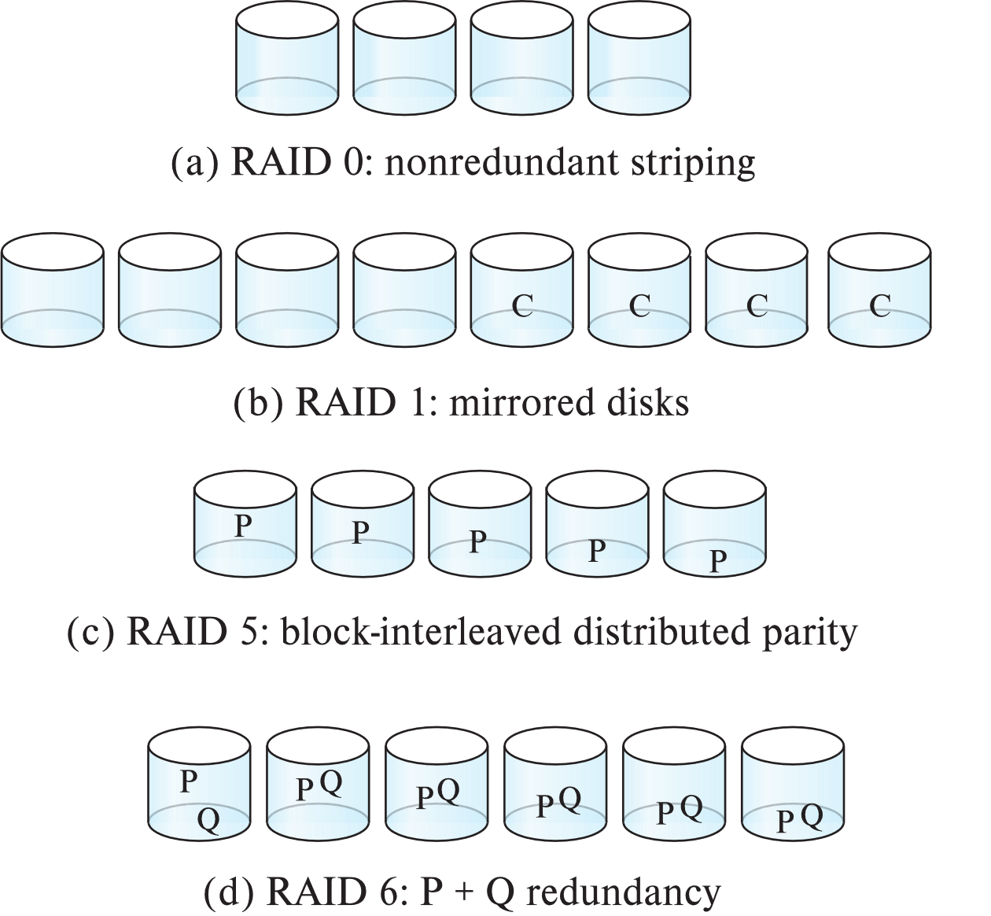
RAID Levels
Schemes to provide redundancy at lower cost by using disk striping combined with parity bits
Different RAID organizations, or RAID levels, have differing cost, performance and reliability characteristics
RAID Level 0: Block striping; non-redundant.
Used in high-performance applications where data loss is not critical.
RAID Level 1: Mirrored disks with block striping
Offers best write performance.
Popular for applications such as storing log files in a database system.

Slide 44
RAID Levels (Cont.)
Parity blocks: Parity block j stores XOR of bits from block j of each disk
When writing data to a block j, parity block j must also be computed and written to disk
Can be done by using old parity block, old value of current block and new value of current block (2 block reads + 2 block writes)
Or by recomputing the parity value using the new values of blocks corresponding to the parity block
More efficient for writing large amounts of data sequentially
To recover data for a block, compute XOR of bits from all other blocks in the set including the parity block

Slide 45
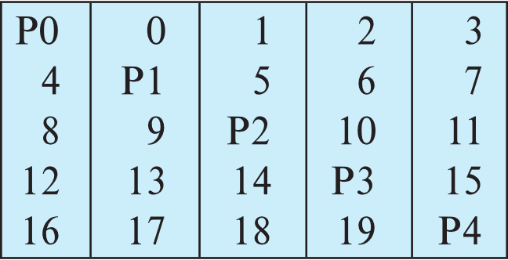
RAID Levels (Cont.)
RAID Level 5: Block-Interleaved Distributed Parity; partitions data and parity among all N + 1 disks, rather than storing data in N disks and parity in 1 disk.
E.g., with 5 disks, parity block for nth set of blocks is stored on disk (n mod 5) + 1, with the data blocks stored on the other 4 disks.

Slide 46
RAID Levels (Cont.)
RAID Level 5 (Cont.)
Block writes occur in parallel if the blocks and their parity blocks are on different disks.
RAID Level 6: P+Q Redundancy scheme; similar to Level 5, but stores two error correction blocks (P, Q) instead of single parity block to guard against multiple disk failures.
Better reliability than Level 5 at a higher cost
Becoming more important as storage sizes increase

Slide 47
RAID Levels (Cont.)
Other levels (not used in practice):
RAID Level 2: Memory-Style Error-Correcting-Codes (ECC) with bit striping.
RAID Level 3: Bit-Interleaved Parity
RAID Level 4: Block-Interleaved Parity; uses block-level striping, and keeps a parity block on a separate parity disk for corresponding blocks from N other disks.
RAID 5 is better than RAID 4, since with RAID 4 with random writes, parity disk gets much higher write load than other disks and becomes a bottleneck

Slide 48
Choice of RAID Level
Factors in choosing RAID level
Monetary cost
Performance: Number of I/O operations per second, and bandwidth during normal operation
Performance during failure
Performance during rebuild of failed disk
Including time taken to rebuild failed disk
RAID 0 is used only when data safety is not important
E.g., data can be recovered quickly from other sources

Slide 49
Choice of RAID Level (Cont.)
Level 1 provides much better write performance than level 5
Level 5 requires at least 2 block reads and 2 block writes to write a single block, whereas Level 1 only requires 2 block writes
Level 1 had higher storage cost than level 5
Level 5 is preferred for applications where writes are sequential and large (many blocks), and need large amounts of data storage
RAID 1 is preferred for applications with many random/small updates
Level 6 gives better data protection than RAID 5 since it can tolerate two disk (or disk block) failures
Increasing in importance since latent block failures on one disk, coupled with a failure of another disk can result in data loss with RAID 1 and RAID 5.

Slide 50
Hardware Issues
Software RAID: RAID implementations done entirely in software, with no special hardware support
Hardware RAID: RAID implementations with special hardware
Use non-volatile RAM to record writes that are being executed
Beware: power failure during write can result in corrupted disk
E.g., failure after writing one block but before writing the second in a mirrored system
Such corrupted data must be detected when power is restored
Recovery from corruption is similar to recovery from failed disk
NV-RAM helps to efficiently detected potentially corrupted blocks
Otherwise all blocks of disk must be read and compared with mirror/parity block

Slide 51
Hardware Issues (Cont.)
Latent failures: data successfully written earlier gets damaged
can result in data loss even if only one disk fails
Data scrubbing:
continually scan for latent failures, and recover from copy/parity
Hot swapping: replacement of disk while system is running, without power down
Supported by some hardware RAID systems,
reduces time to recovery, and improves availability greatly
Many systems maintain spare disks which are kept online, and used as replacements for failed disks immediately on detection of failure
Reduces time to recovery greatly
Many hardware RAID systems ensure that a single point of failure will not stop the functioning of the system by using
Redundant power supplies with battery backup
Multiple controllers and multiple interconnections to guard against controller/interconnection failures

Slide 52
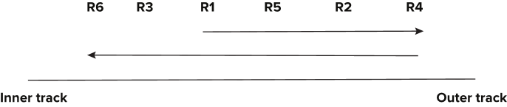
Optimization of Disk-Block Access
Buffering: in-memory buffer to cache disk blocks
Read-ahead: Read extra blocks from a track in anticipation that they will be requested soon
Disk-arm-scheduling algorithms re-order block requests so that disk arm movement is minimized
elevator algorithm

Slide 53
Optimization of Disk-Block Access
Buffering: in-memory buffer to cache disk blocks
Read-ahead: Read extra blocks from a track in anticipation that they will be requested soon
Disk-arm-scheduling algorithms re-order block requests so that disk arm movement is minimized
elevator algorithm
R6
R3
R1
R5
R2
R4
Inner track
Outer track

Slide 54
Disk Scheduling
An example – Elevator Algorithm
Assume
The seek time from track n to m is ABS(n-m).
The I/O request queue is for sectors on tracks 1, 9, 2, 8, 3.
The head is currently on track 5.
Total seek time for FIFO processing
Seek order is 5→1→9→2→8→3
Total seek time is ABS(5-1) + ABS(1-9) + ABS(9-2) + ABS(2-8) + ABS(8-3) = 30
If the head goes all the way up and all the way down, like an elevator,
The seek order 5→8→9→3→2→1
Total seek time is ABS(5-8) + ABS(8-9) + ABS(9-3) + ABS(3-2) + ABS(2-1) = 12
There is a rich body of research and algorithms on optimizing
Blocks on tracks/sectors.
Seek/rotation optimization.

Slide 55
Data Access Patterns
Think about accessing tuples in a database. The access patterns are not completely random. For example,
SELECT … ORDER BY … ➔ I look for things in sequence.
SELECT … WHERE last_name=“Smith” ➔ I look for sets of things.
CREATE VIEW AS SELECT … FROM JOIN … ON A.x=B.y ➔ I look for things in pairs of sets.
Optimizing I/O performance
Group records into blocks if accessed together.
Group blocks onto the same sector/cylinder if accessed together/sequentially ➔ Eliminates seek time.
Schedule access:
If I have to read cylinders 1, 9, 2, 8, 3
A better ordering is 1,2,3,9,8.
Stripe across disks: Read one block from 10 disks instead one 10 from 1.
Pre-fetch and preload.

Slide 56
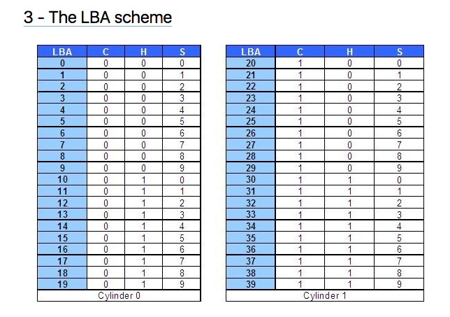
Logical Block Addressing (https://gerardnico.com/wiki/data_storage/lba)
CHS addresses can be converted to LBA addresses using the following formula:
LBA = (( C x HPC ) + H ) x SPT + S – 1
where,
C, H and S are the cylinder number, the head number, and the sector number
LBA is the logical block address
HPC is the number of heads per cylinder
SPT is the number of sectors per track
Devices have configuration and metadata APIs that allow storage manager to
Map between LBA and CHS
To optimize block placement
Based on access patterns, statistics, data schema, etc.

Slide 57
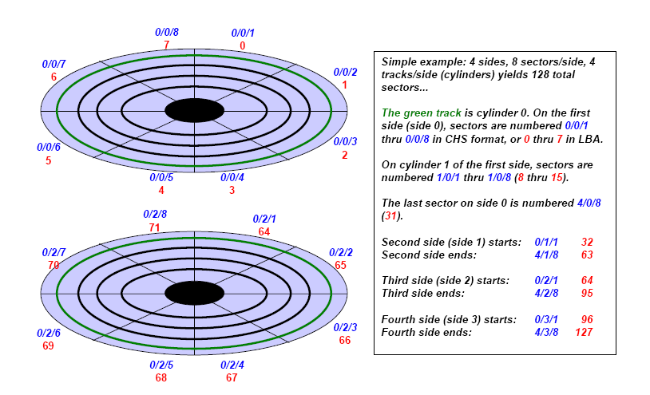
Another View (http://www.c-jump.com/CIS24/Slides/DiskDrives/D01_0150_chs_vs_lba.htm)

Slide 58
Data Storage Structures (Database Systems Concepts, V7, Ch. 13)
58 | Introduction to Databases (F20): Lecture 8: Disks, I/O, Indexes

Slide 59
File Organization
The database is stored as a collection of files. Each file is a sequence of records. A record is a sequence of fields.
One approach
Assume record size is fixed
Each file has records of one particular type only
Different files are used for different relations
This case is easiest to implement; will consider variable length records later
We assume that records are smaller than a disk block
.

Slide 60
Terminology
A tuple in a relation maps to a record. Records may be
Fixed length
Variable length
Variable format (which we will see in Neo4J, DynamoDB, etc).
A block
Is the unit of transfer between disks and memory (buffer pools).
Contains multiple records, usually but not always from the same relation.
The database address space contains
All of the blocks and records that the database manages
Including blocks/records containing data
And blocks/records containing free space.

Slide 61
Fixed Length Record
Sample DDL
CREATE TABLE `products` ( `product_id` char(8) NOT NULL, `product_name` varchar(16) NOT NULL, `product_description` char(8) NOT NULL, `product_brand` enum('IBM','HP','Acer','Lenovo','Some really long brand name') NOT NULL, PRIMARY KEY (`product_id`) ) ENGINE=InnoDB DEFAULT CHARSET=utf8;
Why
Is this fixed length? product_brand and product_name are clearly variable length.
Isn’t char(8) to short for a product description?

Slide 62
Hypothetical Explanations
“In computing, internationalization and localization are means of adapting computer software to different languages, regional differences and technical requirements of a target locale.^{[1]} Internationalization is the process of designing a software application so that it can be adapted to various languages and regions without engineering changes. Localization is the process of adapting internationalized software for a specific region or language by adding locale-specific components and translating text. Localization (which is potentially performed multiple times, for different locales) uses the infrastructure or flexibility provided by internationalization (which is ideally performed only once, or as an integral part of ongoing development).” (https://en.wikipedia.org/wiki/Internationalization_and_localization)
Retrieving a product description may require two elements
Language code, e.g. (EN, DE, ES, …)
Description ID, e.g. 01105432
(EN, 01105432) and (DE, 01105432) are the same description in different languages (English and German)
The description ID is an attribute of the product.
The language is an attribute or property of the user, install location, etc.

Slide 63
Hypothetical Explanations
This concept is
An element of data modeling and design
Not DBMS implementation or data management.
I introduce the concept because
Important, general data model topic we have not covered.
Pattern is a reason why many records we think would be variable are often fixed.
VARCHAR field in a tuple is often
A pointer to a value in some other record.
“In computing, internationalization and localization are means of adapting computer software to different languages, regional differences and technical requirements of a target locale.^{[1]} Internationalization is the process of designing a software application so that it can be adapted to various languages and regions without engineering changes. Localization is the process of adapting internationalized software for a specific region or language by adding locale-specific components and translating text. Localization (which is potentially performed multiple times, for different locales) uses the infrastructure or flexibility provided by internationalization (which is ideally performed only once, or as an integral part of ongoing development).” (https://en.wikipedia.org/wiki/Internationalization_and_localization)
Retrieving a product description may require two elements
Language code, e.g. (EN, DE, ES, …)
Description ID, e.g. 01105432
(EN, 01105432) and (DE, 01105432) are the same description in different languages.
The description ID is an attribute of the product.
The language is an attribute or property of the user, install location, etc.

Slide 64
Hypothetical Explanation
`product_name` varchar(16) NOT NULL
(NB: Assumes that the product_name is not localized).
Length can be 0 .. 15 characters.
But,
If the value is almost always between 12 and 16 characters.
The database engine may decide to store in a fixed length area.
Because the relatively small savings available from treating like a variable length record
Does not justify the added complexity involved in variable size record management.
`product_brand` enum('IBM','HP','Acer','Lenovo','Some really long brand name')
The DB engine would/could represent with a 1 byte code in a lookup table.
This enables simplified, fixed length record management
And saves space because
1,000 products in the catalog from ‘Some really long brand’
Requires 1,000 bytes instead of 27,000 bytes.
Repeated values:
The same value occurring repeatedly in multiple distinct tuples is common, even when not an enum, e.g.
Country names, City names, street names, last names, first names, …
Foreign keys in many-to-many associative entities.
DBMS storage management engine may detect the situation, and replace values with symbol lookups.

Slide 65
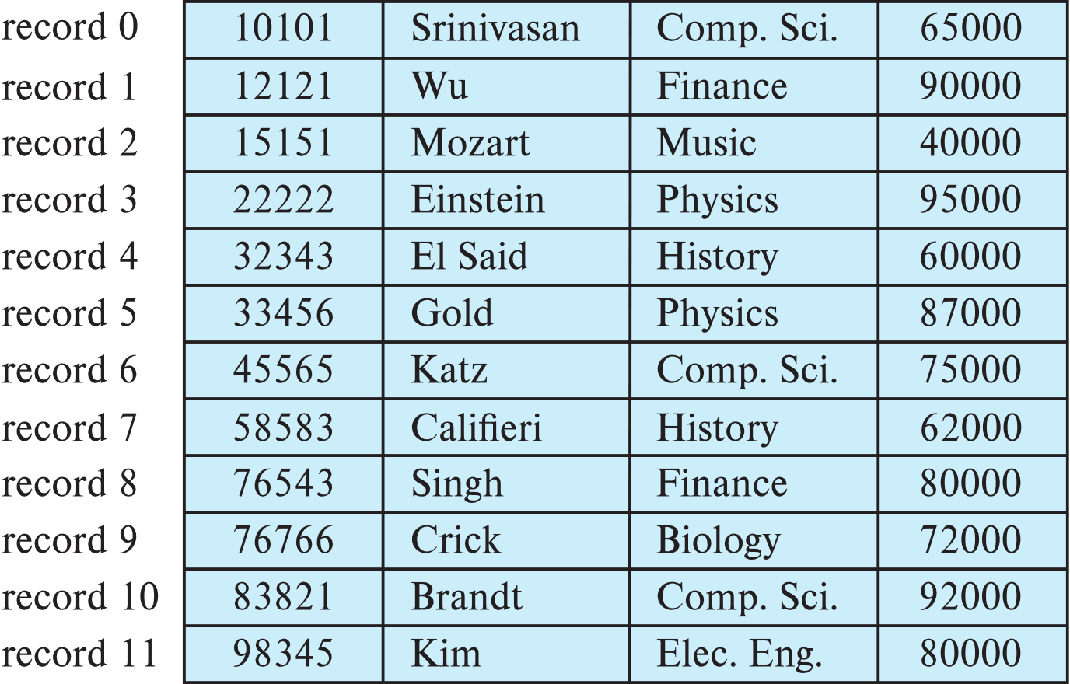
Fixed-Length Records
Simple approach:
Store record i starting from byte n ∗ (i – 1), where n is the size of each record.
Record access is simple but records may cross blocks
Modification: do not allow records to cross block boundaries

Slide 66
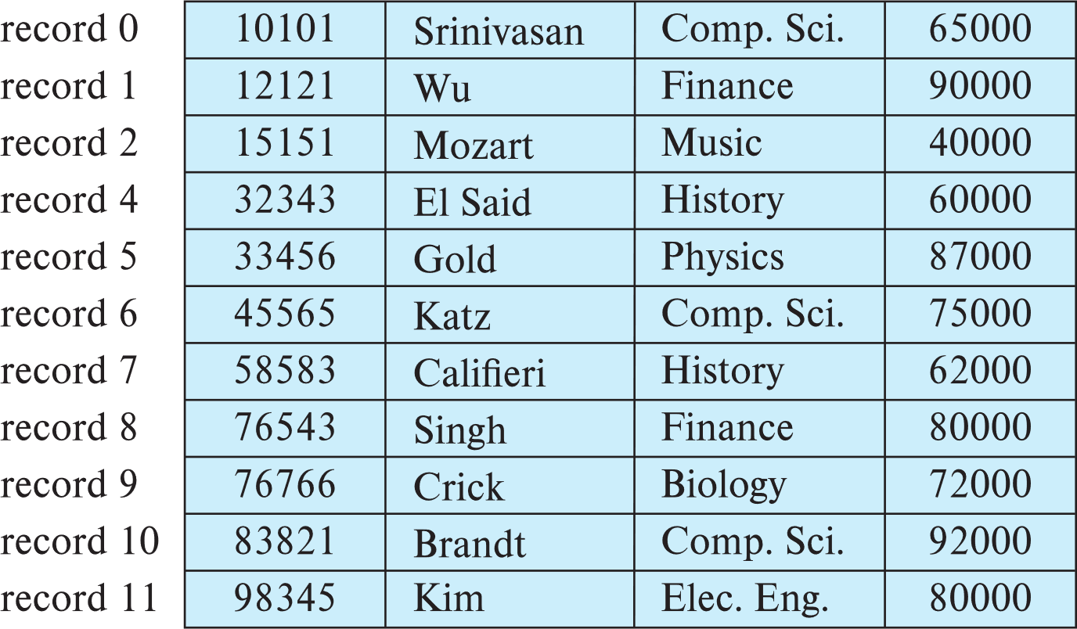
Fixed-Length Records
Deletion of record i: alternatives:
move records i + 1, . . ., n to i, . . . , n – 1
move record n to i
do not move records, but link all free records on a free list
Record 3 deleted

Slide 67
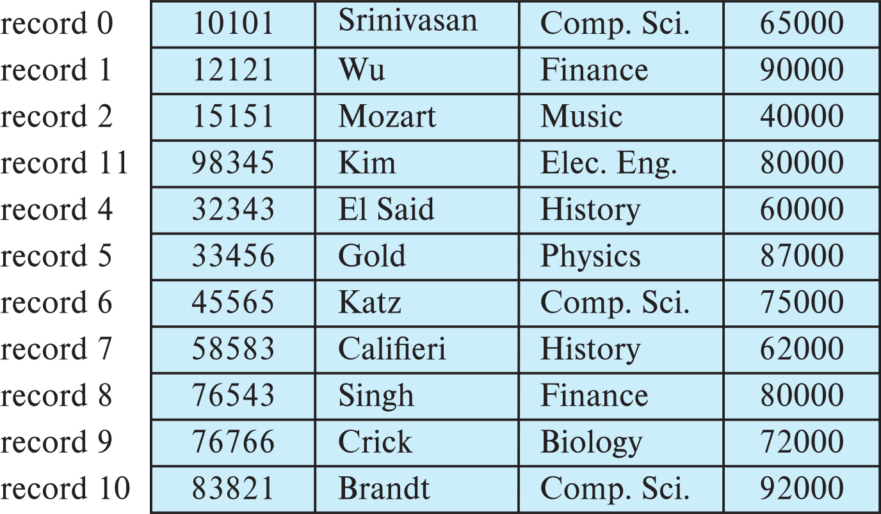
Fixed-Length Records
Deletion of record i: alternatives:
move records i + 1, . . ., n to i, . . . , n – 1
move record n to i
do not move records, but link all free records on a free list
Record 3 deleted and replaced by record 11

Slide 68
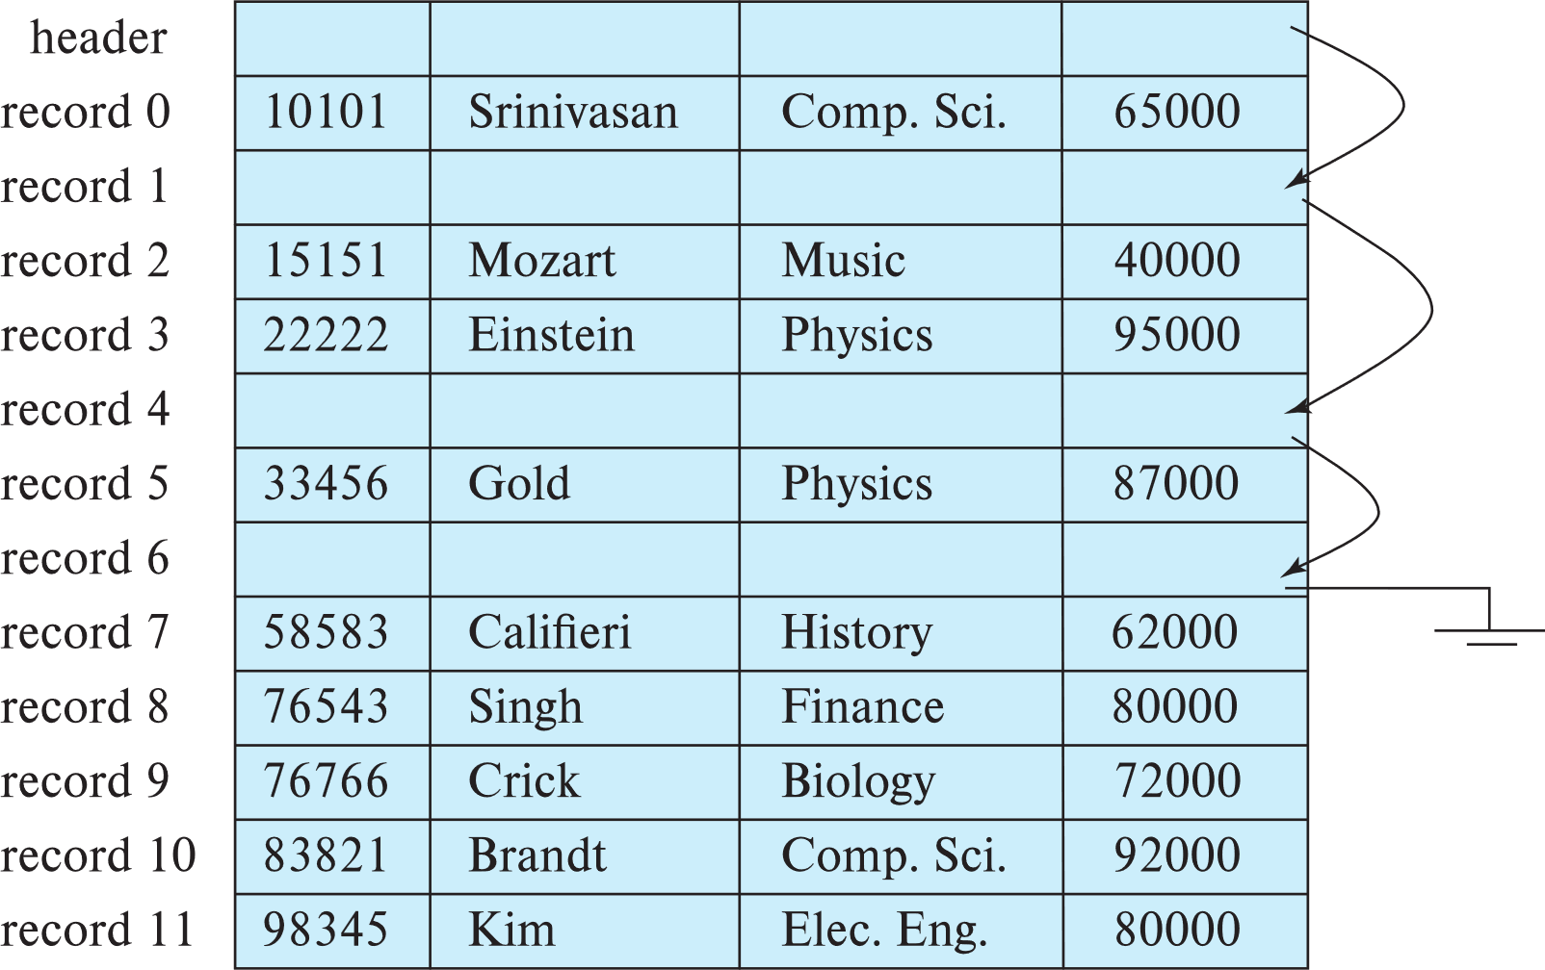
Fixed-Length Records
Deletion of record i: alternatives:
move records i + 1, . . ., n to i, . . . , n – 1
move record n to i
do not move records, but link all free records on a free list

Slide 69
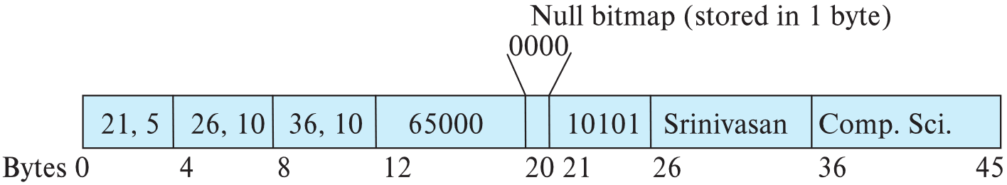
Variable-Length Records
Variable-length records arise in database systems in several ways:
Storage of multiple record types in a file.
Record types that allow variable lengths for one or more fields such as strings (varchar)
Record types that allow repeating fields (used in some older data models).
Attributes are stored in order
Variable length attributes represented by fixed size (offset, length), with actual data stored after all fixed length attributes
Null values represented by null-value bitmap

Slide 70
Variable-Length Records: Slotted Page Structure
Slotted page header contains:
number of record entries
end of free space in the block
location and size of each record
Records can be moved around within a page to keep them contiguous with no empty space between them; entry in the header must be updated.
Pointers should not point directly to record — instead they should point to the entry for the record in header.

Slide 71
Storing Large Objects
E.g., blob/clob types
Records must be smaller than pages
Alternatives:
Store as files in file systems
Store as files managed by database
Break into pieces and store in multiple tuples in separate relation
PostgreSQL TOAST

Slide 72
Organization of Records in Files
Heap – record can be placed anywhere in the file where there is space
Sequential – store records in sequential order, based on the value of the search key of each record
In a multitable clustering file organization records of several different relations can be stored in the same file
Motivation: store related records on the same block to minimize I/O
B⁺-tree file organization
Ordered storage even with inserts/deletes
More on this in Chapter 14
Hashing – a hash function computed on search key; the result specifies in which block of the file the record should be placed
More on this in Chapter 14

Slide 73
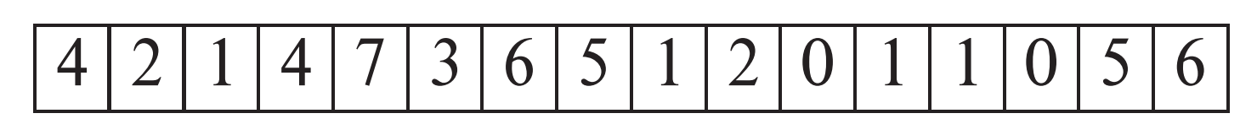
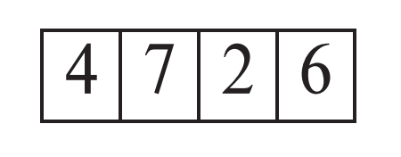
Heap File Organization
Records can be placed anywhere in the file where there is free space
Records usually do not move once allocated
Important to be able to efficiently find free space within file
Free-space map
Array with 1 entry per block. Each entry is a few bits to a byte, and records fraction of block that is free
In example below, 3 bits per block, value divided by 8 indicates fraction of block that is free
Can have second-level free-space map
In example below, each entry stores maximum from 4 entries of first-level free-space map
Free space map written to disk periodically, OK to have wrong (old) values for some entries (will be detected and fixed)

Slide 74
Sequential File Organization
Suitable for applications that require sequential processing of the entire file
The records in the file are ordered by a search-key

Slide 75
Sequential File Organization (Cont.)
Deletion – use pointer chains
Insertion –locate the position where the record is to be inserted
if there is free space insert there
if no free space, insert the record in an overflow block
In either case, pointer chain must be updated
Need to reorganize the file from time to time to restore sequential order

Slide 76
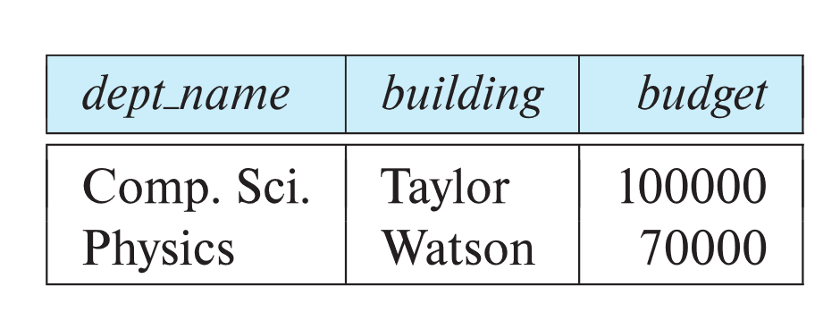
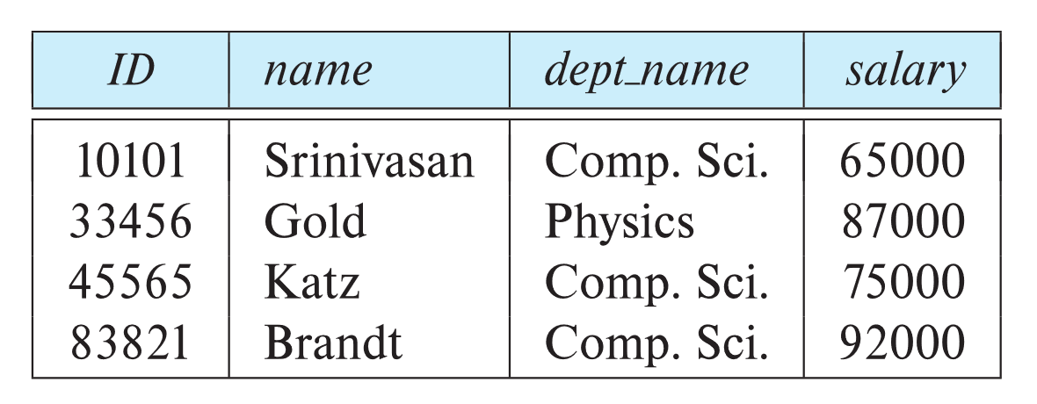
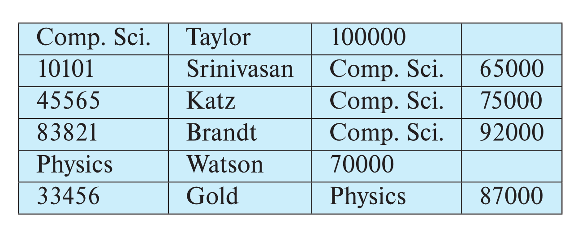
Multitable Clustering File Organization
Store several relations in one file using a multitable clustering file organization
department
instructor
multitable clustering
of department and
instructor

Slide 77
Multitable Clustering File Organization (cont.)
good for queries involving department ⨝ instructor, and for queries involving one single department and its instructors
bad for queries involving only department
results in variable size records
Can add pointer chains to link records of a particular relation

Slide 78
Partitioning
Table partitioning: Records in a relation can be partitioned into smaller relations that are stored separately
E.g., transaction relation may be partitioned into transaction_2018, transaction_2019, etc.
Queries written on transaction must access records in all partitions
Unless query has a selection such as year=2019, in which case only one partition in needed
Partitioning
Reduces costs of some operations such as free space management
Allows different partitions to be stored on different storage devices
E.g., transaction partition for current year on SSD, for older years on magnetic disk

Slide 79
Data Dictionary Storage
The Data dictionary (also called system catalog) stores metadata; that is, data about data, such as
Information about relations
names of relations
names, types and lengths of attributes of each relation
names and definitions of views
integrity constraints
User and accounting information, including passwords
Statistical and descriptive data
number of tuples in each relation
Physical file organization information
How relation is stored (sequential/hash/…)
Physical location of relation
Information about indices (Chapter 14)

Slide 80
Relational Representation of System Metadata
Relational representation on disk
Specialized data structures designed for efficient access, in memory

Slide 81
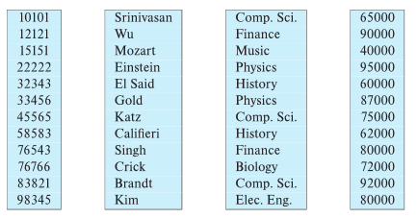
Column-Oriented Storage
Also known as columnar representation
Store each attribute of a relation separately
Example

Slide 82
Columnar Representation
Benefits:
Reduced IO if only some attributes are accessed
Improved CPU cache performance
Improved compression
Vector processing on modern CPU architectures
Drawbacks
Cost of tuple reconstruction from columnar representation
Cost of tuple deletion and update
Cost of decompression
Columnar representation found to be more efficient for decision support than row-oriented representation
Traditional row-oriented representation preferable for transaction processing
Some databases support both representations
Called hybrid row/column stores

Slide 83
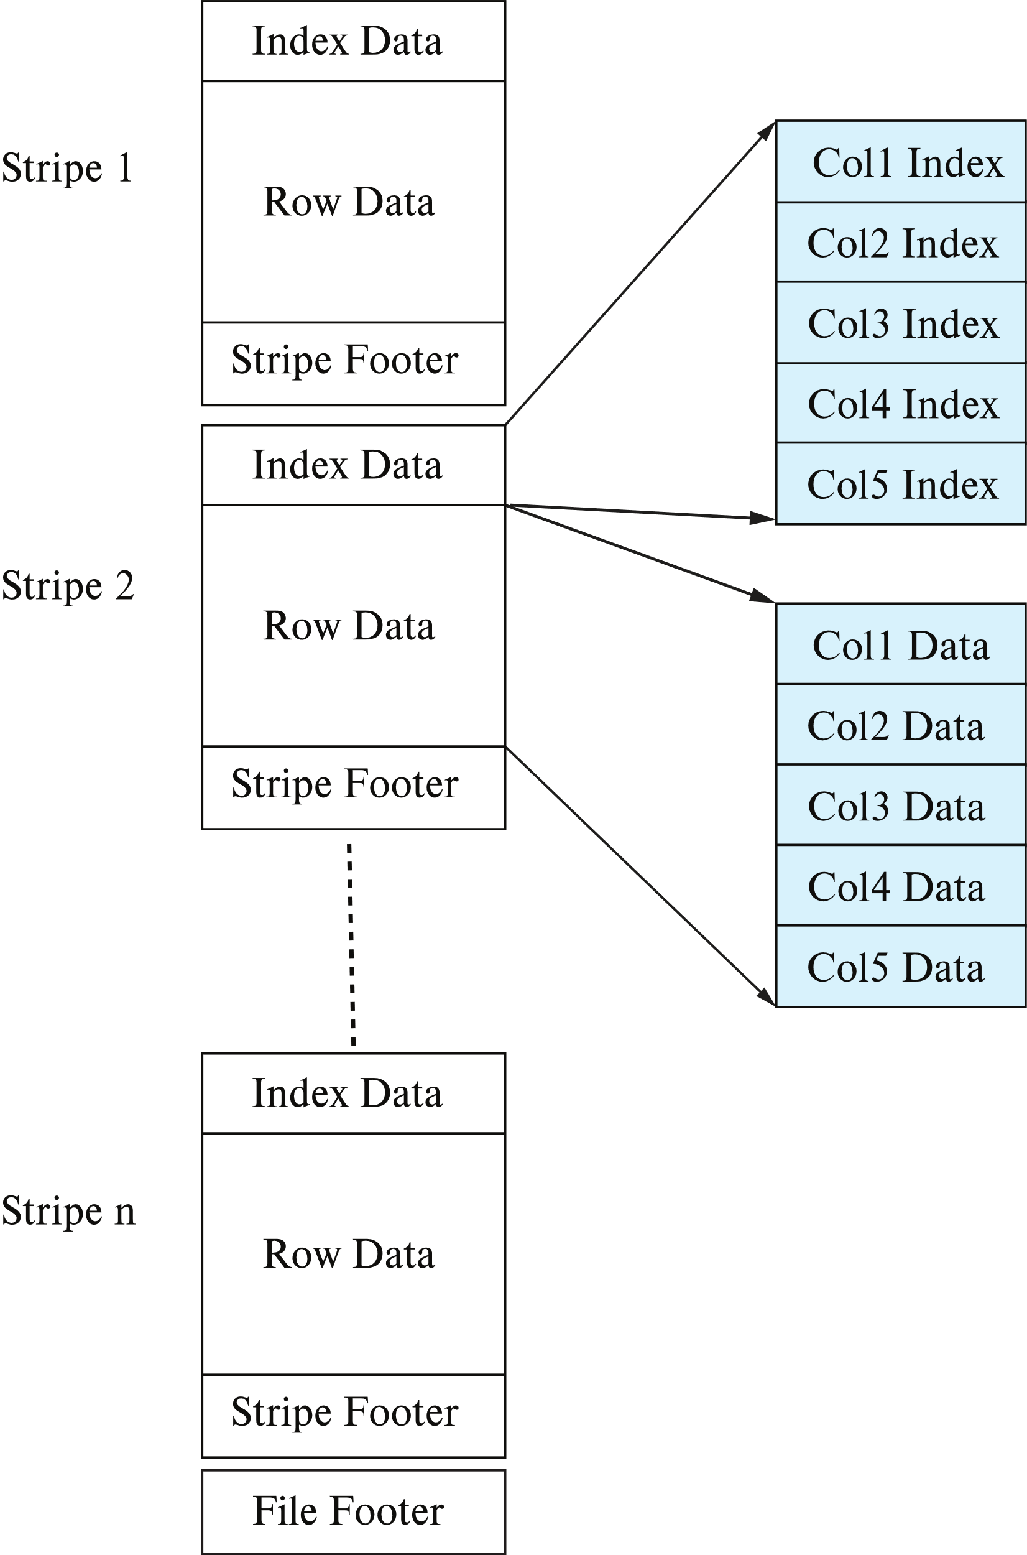
Columnar File Representation
ORC and Parquet: file formats with columnar storage inside file
Very popular for big-data applications
Orc file format shown on right:

Slide 84
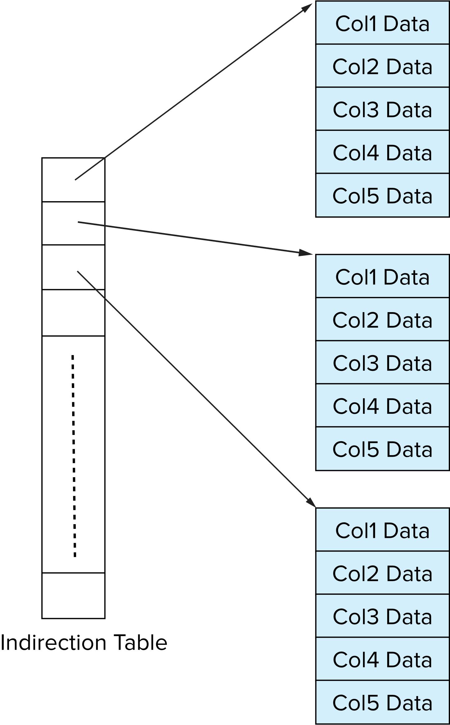
Storage Organization in Main-Memory Databases
Can store records directly in memory without a buffer manager
Column-oriented storage can be used in-memory for decision support applications
Compression reduces memory requirement

Slide 85
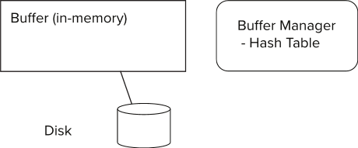
Storage Access
Blocks are units of both storage allocation and data transfer.
Database system seeks to minimize the number of block transfers between the disk and memory. We can reduce the number of disk accesses by keeping as many blocks as possible in main memory.
Buffer – portion of main memory available to store copies of disk blocks.
Buffer manager – subsystem responsible for allocating buffer space in main memory.
Notes:
85

Slide 86
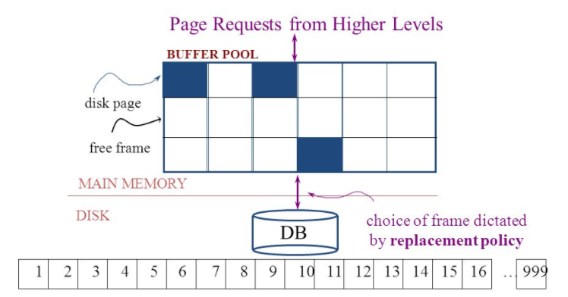
The Logical Concept
The DBMS and queries can only manipulate in-memory blocks and records.
A very, very, very small fraction of all blocks fit in memory.

Slide 87
Buffer Manager
Programs call on the buffer manager when they need a block from disk.
If the block is already in the buffer, buffer manager returns the address of the block in main memory
If the block is not in the buffer, the buffer manager
Allocates space in the buffer for the block
Replacing (throwing out) some other block, if required, to make space for the new block.
Replaced block written back to disk only if it was modified since the most recent time that it was written to/fetched from the disk.
Reads the block from the disk to the buffer, and returns the address of the block in main memory to requester.
Notes:
87

Slide 88
Buffer Manager
Buffer replacement strategy (details coming up!)
Pinned block: memory block that is not allowed to be written back to disk
Pin done before reading/writing data from a block
Unpin done when read /write is complete
Multiple concurrent pin/unpin operations possible
Keep a pin count, buffer block can be evicted only if pin count = 0
Shared and exclusive locks on buffer
Needed to prevent concurrent operations from reading page contents as they are moved/reorganized, and to ensure only one move/reorganize at a time
Readers get shared lock, updates to a block require exclusive lock
Locking rules:
Only one process can get exclusive lock at a time
Shared lock cannot be concurrently with exclusive lock
Multiple processes may be given shared lock concurrently

Slide 89
Buffer-Replacement Policies
Most operating systems replace the block least recently used (LRU strategy)
Idea behind LRU – use past pattern of block references as a predictor of future references
LRU can be bad for some queries
Queries have well-defined access patterns (such as sequential scans), and a database system can use the information in a user’s query to predict future references
Mixed strategy with hints on replacement strategy provided by the query optimizer is preferable
Example of bad access pattern for LRU: when computing the join of 2 relations r and s by a nested loops
for each tuple tr of r do for each tuple ts of s do if the tuples tr and ts match …
Notes:
89

Slide 90
Buffer-Replacement Policies (Cont.)
Toss-immediate strategy – frees the space occupied by a block as soon as the final tuple of that block has been processed
Most recently used (MRU) strategy – system must pin the block currently being processed. After the final tuple of that block has been processed, the block is unpinned, and it becomes the most recently used block.
Buffer manager can use statistical information regarding the probability that a request will reference a particular relation
E.g., the data dictionary is frequently accessed. Heuristic: keep data-dictionary blocks in main memory buffer
Operating system or buffer manager may reorder writes
Can lead to corruption of data structures on disk
E.g., linked list of blocks with missing block on disk
File systems perform consistency check to detect such situations
Careful ordering of writes can avoid many such problems
Notes:
90

Slide 91
Replacement Policy
The replacement policy is one of the most important factors in database management system implementation and configuration.
A very simple, introductory explanation is (https://en.wikipedia.org/wiki/Cache_replacement_policies).
There are a lot of possible policies.
The most efficient caching algorithm would be to always discard the information that will not be needed for the longest time in the future. This optimal result is referred to as Bélády's optimal algorithm/simply optimal replacement policy or the clairvoyant algorithm.
All implementable policies are an attempt to approximate knowledge of the future based on knowledge of the past.
Least Recently Used is based on the simplest assumption
The information that will not be needed for the longest time.
Is the information that has not been accessed for the longest time.

Slide 92
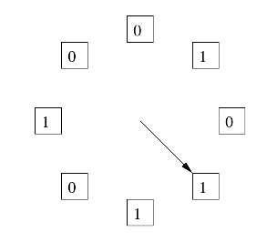
The “Clock Algorithm”
LRU is (perceived to be) expensive
Maintain timestamp for each block.
Update and resort blocks on access.
The “Clock Algorithm” is a less expensive approximation.
Arrange the frames (places blocks can go) into a logical circle like the seconds on a clock face.
Each frame is marked 0 or 1.
Set to 1 when block added to frame.
Or when application accesses a block in frame.
Replacement choice
Sweep second hand clockwise one frame at a time.
If bit is 0, choose for replacement.
If bit is 1, set bit to zero and go to next frame.
The basic idea is. On a clock face
If the second hand is currently at 27 seconds.
The 28 second tick mark is “the least recently touched mark.”

Slide 93
Replacement Algorithm
The algorithms are more sophisticated in the real world, e.g.
“Scans” are common, e.g. go through a large query result in order (will be more clear when discussing cursors).
The engine knows the current position in the result set.
Uses the sort order to determine which records will be accessed soon.
Tags those blocks as not replaceable.
(A form of clairvoyance).
Not all users/applications are equally “important.”
Classify users/applications into priority 1, 2 and 3.
Sub-allocate the buffer pool into pools P1, P2 and P3.
Apply LRU within pools and adjust pool sizes based on relative importance.
This prevents
A high access rate, low-priority application from taking up a lot of frames
Result in low access, high priority applications not getting buffer hits.

Slide 94
Optimization of Disk Block Access (Cont.)
Buffer managers support forced output of blocks for the purpose of recovery (more in Chapter 19)
Nonvolatile write buffers speed up disk writes by writing blocks to a non-volatile RAM or flash buffer immediately
Writes can be reordered to minimize disk arm movement
Log disk – a disk devoted to writing a sequential log of block updates
Used exactly like nonvolatile RAM
Write to log disk is very fast since no seeks are required
Journaling file systems write data in-order to NV-RAM or log disk
Reordering without journaling: risk of corruption of file system data

Slide 95
Indexesres (Database Systems Concepts, V7, Ch. 14)
95 | Introduction to Databases (F20): Lecture 8: Disks, I/O, Indexes

Slide 96
Outline
Basic Concepts
Ordered Indices
B⁺-Tree Index Files
B-Tree Index Files
Hashing
Write-optimized indices
Spatio-Temporal Indexing

Slide 97
Basic Concepts
Indexing mechanisms used to speed up access to desired data.
E.g., author catalog in library
Search Key - attribute to set of attributes used to look up records in a file.
An index file consists of records (called index entries) of the form
Index files are typically much smaller than the original file
Two basic kinds of indices:
Ordered indices: search keys are stored in sorted order
Hash indices: search keys are distributed uniformly across “buckets” using a “hash function”.
search-key
pointer

Slide 98
Index Evaluation Metrics
Access types supported efficiently. E.g.,
Records with a specified value in the attribute
Records with an attribute value falling in a specified range of values.
Access time
Insertion time
Deletion time
Space overhead

Slide 99
Ordered Indices
In an ordered index, index entries are stored sorted on the search key value.
Clustering index: in a sequentially ordered file, the index whose search key specifies the sequential order of the file.
Also called primary index
The search key of a primary index is usually but not necessarily the primary key.
Secondary index: an index whose search key specifies an order different from the sequential order of the file. Also called nonclustering index.
Index-sequential file: sequential file ordered on a search key, with a clustering index on the search key.

Slide 100
Dense Index Files
Dense index — Index record appears for every search-key value in the file.
E.g. index on ID attribute of instructor relation

Slide 101
Dense Index Files (Cont.)
Dense index on dept_name, with instructor file sorted on dept_name

Slide 102
Sparse Index Files
Sparse Index: contains index records for only some search-key values.
Applicable when records are sequentially ordered on search-key
To locate a record with search-key value K we:
Find index record with largest search-key value < K
Search file sequentially starting at the record to which the index record points

Slide 103
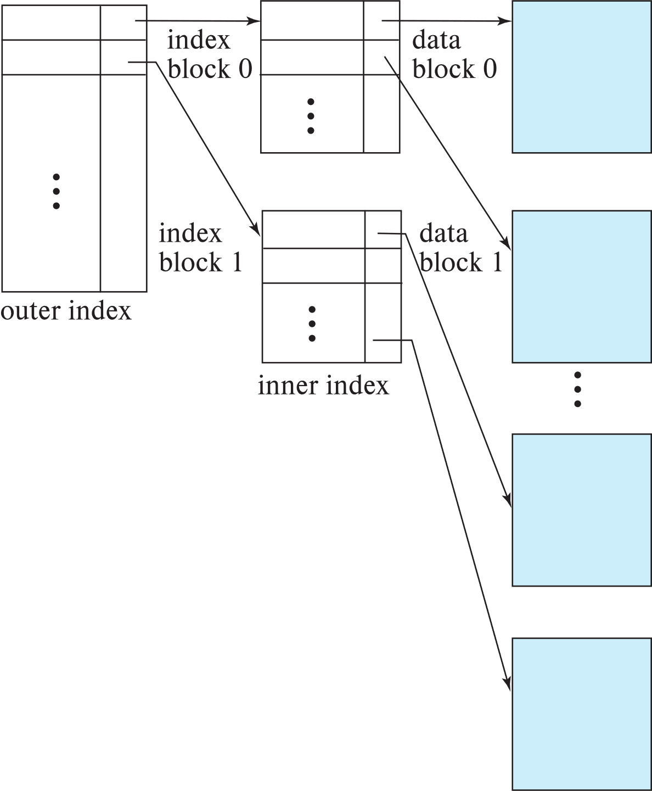
Sparse Index Files (Cont.)
Compared to dense indices:
Less space and less maintenance overhead for insertions and deletions.
Generally slower than dense index for locating records.
Good tradeoff:
for clustered index: sparse index with an index entry for every block in file, corresponding to least search-key value in the block.
For unclustered index: sparse index on top of dense index (multilevel index)

Slide 104
Secondary Indices Example
Secondary index on salary field of instructor
Index record points to a bucket that contains pointers to all the actual records with that particular search-key value.
Secondary indices have to be dense

Slide 105
Clustering vs Nonclustering Indices
Indices offer substantial benefits when searching for records.
BUT: indices imposes overhead on database modification
when a record is inserted or deleted, every index on the relation must be updated
When a record is updated, any index on an updated attribute must be updated
Sequential scan using clustering index is efficient, but a sequential scan using a secondary (nonclustering) index is expensive on magnetic disk
Each record access may fetch a new block from disk
Each block fetch on magnetic disk requires about 5 to 10 milliseconds

Slide 106
Multilevel Index
If index does not fit in memory, access becomes expensive.
Solution: treat index kept on disk as a sequential file and construct a sparse index on it.
outer index – a sparse index of the basic index
inner index – the basic index file
If even outer index is too large to fit in main memory, yet another level of index can be created, and so on.
Indices at all levels must be updated on insertion or deletion from the file.

Slide 107
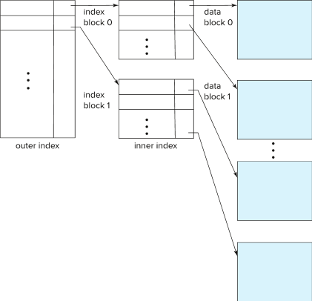
Multilevel Index (Cont.)

Slide 108
Index Update: Deletion
If deleted record was the only record in the file with its particular search-key value, the search-key is deleted from the index also.
Single-level index entry deletion:
Dense indices – deletion of search-key is similar to file record deletion.
Sparse indices –
if an entry for the search key exists in the index, it is deleted by replacing the entry in the index with the next search-key value in the file (in search-key order).
If the next search-key value already has an index entry, the entry is deleted instead of being replaced.

Slide 109
Index Update: Insertion
Single-level index insertion:
Perform a lookup using the search-key value of the record to be inserted.
Dense indices – if the search-key value does not appear in the index, insert it
Indices are maintained as sequential files
Need to create space for new entry, overflow blocks may be required
Sparse indices – if index stores an entry for each block of the file, no change needs to be made to the index unless a new block is created.
If a new block is created, the first search-key value appearing in the new block is inserted into the index.
Multilevel insertion and deletion: algorithms are simple extensions of the single-level algorithms

Slide 110
Indices on Multiple Keys
Composite search key
E.g., index on instructor relation on attributes (name, ID)
Values are sorted lexicographically
E.g. (John, 12121) < (John, 13514) and (John, 13514) < (Peter, 11223)
Can query on just name, or on (name, ID)

Slide 111
B⁺-Tree Index Files
Disadvantage of indexed-sequential files
Performance degrades as file grows, since many overflow blocks get created.
Periodic reorganization of entire file is required.
Advantage of B⁺-tree index files:
Automatically reorganizes itself with small, local, changes, in the face of insertions and deletions.
Reorganization of entire file is not required to maintain performance.
(Minor) disadvantage of B⁺-trees:
Extra insertion and deletion overhead, space overhead.
Advantages of B⁺-trees outweigh disadvantages
B⁺-trees are used extensively

Slide 112
Example of B⁺-Tree

Slide 113
B⁺-Tree Index Files (Cont.)
A B⁺-tree is a rooted tree satisfying the following properties:
All paths from root to leaf are of the same length
Each node that is not a root or a leaf has between ⎡n/2⎤ and n children.
A leaf node has between ⎡(n–1)/2⎤ and n–1 values
Special cases:
If the root is not a leaf, it has at least 2 children.
If the root is a leaf (that is, there are no other nodes in the tree), it can have between 0 and (n–1) values.

Slide 114
B⁺-Tree Node Structure
Typical node
K_{i} are the search-key values
P_{i} are pointers to children (for non-leaf nodes) or pointers to records or buckets of records (for leaf nodes).
The search-keys in a node are ordered
K₁ < K₂ < K₃ < . . . < K_{n–1}
(Initially assume no duplicate keys, address duplicates later)

Slide 115
Leaf Nodes in B⁺-Trees
Properties of a leaf node:
For i = 1, 2, . . ., n–1, pointer P_{i} points to a file record with search-key value K_{i},
If L_{i}, L_{j} are leaf nodes and i < j, L_{i}’s search-key values are less than or equal to L_{j}’s search-key values
P_{n} points to next leaf node in search-key order

Slide 116
Non-Leaf Nodes in B⁺-Trees
Non leaf nodes form a multi-level sparse index on the leaf nodes. For a non-leaf node with m pointers:
All the search-keys in the subtree to which P₁ points are less than K₁
For 2 ≤ i ≤ n – 1, all the search-keys in the subtree to which P_{i} points have values greater than or equal to K_{i–1} and less than K_{i}
All the search-keys in the subtree to which P_{n} points have values greater than or equal to K_{n–1}
General structure

Slide 117
Example of B⁺-tree
B⁺-tree for instructor file (n = 6)
Leaf nodes must have between 3 and 5 values (⎡(n–1)/2⎤ and n –1, with n = 6).
Non-leaf nodes other than root must have between 3 and 6 children (⎡(n/2⎤ and n with n =6).
Root must have at least 2 children.

Slide 118
Observations about B⁺-trees
Since the inter-node connections are done by pointers, “logically” close blocks need not be “physically” close.
The non-leaf levels of the B⁺-tree form a hierarchy of sparse indices.
The B⁺-tree contains a relatively small number of levels
Level below root has at least 2* ⎡n/2⎤ values
Next level has at least 2* ⎡n/2⎤ * ⎡n/2⎤ values
.. etc.
If there are K search-key values in the file, the tree height is no more than ⎡ log_{⎡n/2⎤}(K)⎤
thus searches can be conducted efficiently.
Insertions and deletions to the main file can be handled efficiently, as the index can be restructured in logarithmic time (as we shall see).

Slide 119
Queries on B⁺-Trees
function find(v)
1. C=root
2. while (C is not a leaf node)
Let i be least number s.t. V ≤ K_{i}.
if there is no such number i then
Set C = last non-null pointer in C
else if (v = C.K_{i} ) Set C = P_{i +1}
else set C = C.P_{i}
3. if for some i, K_{i} = V then return C.P_{i}
4. else return null /* no record with search-key value v exists. */

Slide 120
Queries on B⁺-Trees (Cont.)
Range queries find all records with search key values in a given range
See book for details of function findRange(lb, ub) which returns set of all such records
Real implementations usually provide an iterator interface to fetch matching records one at a time, using a next() function

Slide 121
Queries on B⁺⁻Trees (Cont.)
If there are K search-key values in the file, the height of the tree is no more than ⎡log_{⎡n/2⎤}(K)⎤.
A node is generally the same size as a disk block, typically 4 kilobytes
and n is typically around 100 (40 bytes per index entry).
With 1 million search key values and n = 100
at most log₅₀(1,000,000) = 4 nodes are accessed in a lookup traversal from root to leaf.
Contrast this with a balanced binary tree with 1 million search key values — around 20 nodes are accessed in a lookup
above difference is significant since every node access may need a disk I/O, costing around 20 milliseconds

Slide 122
Non-Unique Keys
If a search key a_{i} is not unique, create instead an index on a composite key (a_{i} , A_{p}), which is unique
A_{p} could be a primary key, record ID, or any other attribute that guarantees uniqueness
Search for a_{i} = v can be implemented by a range search on composite key, with range (v, - ∞) to (v, + ∞)
But more I/O operations are needed to fetch the actual records
If the index is clustering, all accesses are sequential
If the index is non-clustering, each record access may need an I/O operation

Slide 123
Updates on B⁺-Trees: Insertion
Assume record already added to the file. Let
pr be pointer to the record, and let
v be the search key value of the record
Find the leaf node in which the search-key value would appear
If there is room in the leaf node, insert (v, pr) pair in the leaf node
Otherwise, split the node (along with the new (v, pr) entry) as discussed in the next slide, and propagate updates to parent nodes.

Slide 124
Updates on B⁺-Trees: Insertion (Cont.)
Splitting a leaf node:
take the n (search-key value, pointer) pairs (including the one being inserted) in sorted order. Place the first ⎡n/2⎤ in the original node, and the rest in a new node.
let the new node be p, and let k be the least key value in p. Insert (k,p) in the parent of the node being split.
If the parent is full, split it and propagate the split further up.
Splitting of nodes proceeds upwards till a node that is not full is found.
In the worst case the root node may be split increasing the height of the tree by 1.
Result of splitting node containing Brandt, Califieri and Crick on inserting Adams
Next step: insert entry with (Califieri, pointer-to-new-node) into parent

Slide 125
B⁺-Tree Insertion
Affected nodes
B⁺-Tree before and after insertion of “Adams”

Slide 126
B⁺-Tree Insertion
B⁺-Tree before and after insertion of “Lamport”
Affected nodes
Affected nodes

Slide 127
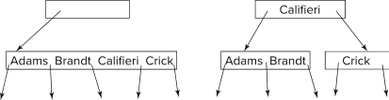
Insertion in B⁺-Trees (Cont.)
Splitting a non-leaf node: when inserting (k,p) into an already full internal node N
Copy N to an in-memory area M with space for n+1 pointers and n keys
Insert (k,p) into M
Copy P₁,K₁, …, K _{⎡n/2⎤-1},P _{⎡n/2⎤} from M back into node N
Copy P_{⎡n/2⎤+1},K _{⎡n/2⎤+1},…,K_{n},P_{n+1} from M into newly allocated node N'
Insert (K _{⎡n/2⎤},N') into parent N
Example
Read pseudocode in book!

Slide 128
Examples of B⁺-Tree Deletion
Before and after deleting “Srinivasan”
Affected nodes
Deleting “Srinivasan” causes merging of under-full leaves

Slide 129
Examples of B⁺-Tree Deletion (Cont.)
Before and after deleting “Singh” and “Wu”
Affected nodes
Leaf containing Singh and Wu became underfull, and borrowed a value Kim from its left sibling
Search-key value in the parent changes as a result

Slide 130
Example of B⁺-tree Deletion (Cont.)
Before and after deletion of “Gold”
Node with Gold and Katz became underfull, and was merged with its sibling
Parent node becomes underfull, and is merged with its sibling
Value separating two nodes (at the parent) is pulled down when merging
Root node then has only one child, and is deleted

Slide 131
Updates on B⁺-Trees: Deletion
Assume record already deleted from file. Let V be the search key value of the record, and Pr be the pointer to the record.
Remove (Pr, V) from the leaf node
If the node has too few entries due to the removal, and the entries in the node and a sibling fit into a single node, then merge siblings:
Insert all the search-key values in the two nodes into a single node (the one on the left), and delete the other node.
Delete the pair (K_{i–1}, P_{i}), where P_{i} is the pointer to the deleted node, from its parent, recursively using the above procedure.

Slide 132
Updates on B⁺-Trees: Deletion
Otherwise, if the node has too few entries due to the removal, but the entries in the node and a sibling do not fit into a single node, then redistribute pointers:
Redistribute the pointers between the node and a sibling such that both have more than the minimum number of entries.
Update the corresponding search-key value in the parent of the node.
The node deletions may cascade upwards till a node which has ⎡n/2⎤ or more pointers is found.
If the root node has only one pointer after deletion, it is deleted and the sole child becomes the root.

Slide 133
Complexity of Updates
Cost (in terms of number of I/O operations) of insertion and deletion of a single entry proportional to height of the tree
With K entries and maximum fanout of n, worst case complexity of insert/delete of an entry is O(log_{⎡n/2⎤}(K))
In practice, number of I/O operations is less:
Internal nodes tend to be in buffer
Splits/merges are rare, most insert/delete operations only affect a leaf node
Average node occupancy depends on insertion order
2/3rds with random, ½ with insertion in sorted order

Slide 134
Non-Unique Search Keys
Alternatives to scheme described earlier
Buckets on separate block (bad idea)
List of tuple pointers with each key
Extra code to handle long lists
Deletion of a tuple can be expensive if there are many duplicates on search key (why?)
Worst case complexity may be linear!
Low space overhead, no extra cost for queries
Make search key unique by adding a record-identifier
Extra storage overhead for keys
Simpler code for insertion/deletion
Widely used
Notes:
134

Slide 135
B⁺-Tree File Organization
B⁺-Tree File Organization:
Leaf nodes in a B⁺-tree file organization store records, instead of pointers
Helps keep data records clustered even when there are insertions/deletions/updates
Leaf nodes are still required to be half full
Since records are larger than pointers, the maximum number of records that can be stored in a leaf node is less than the number of pointers in a nonleaf node.
Insertion and deletion are handled in the same way as insertion and deletion of entries in a B⁺-tree index.

Slide 136
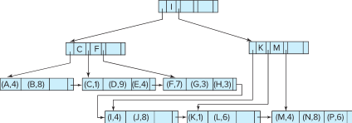
B⁺-Tree File Organization (Cont.)
Example of B+-tree File Organization
Good space utilization important since records use more space than pointers.
To improve space utilization, involve more sibling nodes in redistribution during splits and merges
Involving 2 siblings in redistribution (to avoid split / merge where possible) results in each node having at least entries

Slide 137
Other Issues in Indexing
Record relocation and secondary indices
If a record moves, all secondary indices that store record pointers have to be updated
Node splits in B⁺-tree file organizations become very expensive
Solution: use search key of B⁺-tree file organization instead of record pointer in secondary index
Add record-id if B⁺-tree file organization search key is non-unique
Extra traversal of file organization to locate record
Higher cost for queries, but node splits are cheap
Notes:
137

Slide 138
Indexing Strings
Variable length strings as keys
Variable fanout
Use space utilization as criterion for splitting, not number of pointers
Prefix compression
Key values at internal nodes can be prefixes of full key
Keep enough characters to distinguish entries in the subtrees separated by the key value
E.g., “Silas” and “Silberschatz” can be separated by “Silb”
Keys in leaf node can be compressed by sharing common prefixes

Slide 139
Bulk Loading and Bottom-Up Build
Inserting entries one-at-a-time into a B⁺-tree requires ≥ 1 IO per entry
assuming leaf level does not fit in memory
can be very inefficient for loading a large number of entries at a time (bulk loading)
Efficient alternative 1:
sort entries first (using efficient external-memory sort algorithms discussed later in Section 12.4)
insert in sorted order
insertion will go to existing page (or cause a split)
much improved IO performance, but most leaf nodes half full
Efficient alternative 2: Bottom-up B⁺-tree construction
As before sort entries
And then create tree layer-by-layer, starting with leaf level
details as an exercise
Implemented as part of bulk-load utility by most database systems

Slide 140
B-Tree Index Files
Similar to B+-tree, but B-tree allows search-key values to appear only once; eliminates redundant storage of search keys.
Search keys in nonleaf nodes appear nowhere else in the B-tree; an additional pointer field for each search key in a nonleaf node must be included.
Generalized B-tree leaf node
Nonleaf node – pointers Bi are the bucket or file record pointers.

Slide 141
B-Tree Index Files (Cont.)
Advantages of B-Tree indices:
May use less tree nodes than a corresponding B⁺-Tree.
Sometimes possible to find search-key value before reaching leaf node.
Disadvantages of B-Tree indices:
Only small fraction of all search-key values are found early
Non-leaf nodes are larger, so fan-out is reduced. Thus, B-Trees typically have greater depth than corresponding B⁺-Tree
Insertion and deletion more complicated than in B⁺-Trees
Implementation is harder than B⁺-Trees.
Typically, advantages of B-Trees do not out weigh disadvantages.

Slide 142
B-Tree Index File Example
B-tree (above) and B+-tree (below) on same data

Slide 143
Indexing on Flash
Random I/O cost much lower on flash
20 to 100 microseconds for read/write
Writes are not in-place, and (eventually) require a more expensive erase
Optimum page size therefore much smaller
Bulk-loading still useful since it minimizes page erases
Write-optimized tree structures (discussed later) have been adapted to minimize page writes for flash-optimized search trees

Slide 144
Indexing in Main Memory
Random access in memory
Much cheaper than on disk/flash
But still expensive compared to cache read
Data structures that make best use of cache preferable
Binary search for a key value within a large B⁺-tree node results in many cache misses
B⁺- trees with small nodes that fit in cache line are preferable to reduce cache misses
Key idea: use large node size to optimize disk access, but structure data within a node using a tree with small node size, instead of using an array.

Slide 145
Hashing

Slide 146
Static Hashing
A bucket is a unit of storage containing one or more entries (a bucket is typically a disk block).
we obtain the bucket of an entry from its search-key value using a hash function
Hash function h is a function from the set of all search-key values K to the set of all bucket addresses B.
Hash function is used to locate entries for access, insertion as well as deletion.
Entries with different search-key values may be mapped to the same bucket; thus entire bucket has to be searched sequentially to locate an entry.
In a hash index, buckets store entries with pointers to records
In a hash file-organization buckets store records

Slide 147
Handling of Bucket Overflows
Bucket overflow can occur because of
Insufficient buckets
Skew in distribution of records. This can occur due to two reasons:
multiple records have same search-key value
chosen hash function produces non-uniform distribution of key values
Although the probability of bucket overflow can be reduced, it cannot be eliminated; it is handled by using overflow buckets.

Slide 148
Handling of Bucket Overflows (Cont.)
Overflow chaining – the overflow buckets of a given bucket are chained together in a linked list.
Above scheme is called closed addressing (also called closed hashing or open hashing depending on the book you use)
An alternative, called open addressing (also called open hashing or closed hashing depending on the book you use) which does not use over- flow buckets, is not suitable for database applications.

Slide 149
Example of Hash File Organization
Hash file organization of instructor file, using dept_name as key (See figure in next slide.)
There are 10 buckets,
The binary representation of the I ^{th} character is assumed to be the integer i.
The hash function returns the sum of the binary representations of the characters modulo 10
E.g. h(Music) = 1 h(History) = 2 h(Physics) = 3 h(Elec. Eng.) = 3

Slide 150
Example of Hash File Organization
Hash file organization of instructor file, using dept_name as key.

Slide 151
Deficiencies of Static Hashing
In static hashing, function h maps search-key values to a fixed set of B of bucket addresses. Databases grow or shrink with time.
If initial number of buckets is too small, and file grows, performance will degrade due to too much overflows.
If space is allocated for anticipated growth, a significant amount of space will be wasted initially (and buckets will be underfull).
If database shrinks, again space will be wasted.
One solution: periodic re-organization of the file with a new hash function
Expensive, disrupts normal operations
Better solution: allow the number of buckets to be modified dynamically.

Slide 152
Dynamic Hashing
Periodic rehashing
If number of entries in a hash table becomes (say) 1.5 times size of hash table,
create new hash table of size (say) 2 times the size of the previous hash table
Rehash all entries to new table
Linear Hashing
Do rehashing in an incremental manner
Extendable Hashing
Tailored to disk based hashing, with buckets shared by multiple hash values
Doubling of # of entries in hash table, without doubling # of buckets

Slide 153
Comparison of Ordered Indexing and Hashing
Cost of periodic re-organization
Relative frequency of insertions and deletions
Is it desirable to optimize average access time at the expense of worst-case access time?
Expected type of queries:
Hashing is generally better at retrieving records having a specified value of the key.
If range queries are common, ordered indices are to be preferred
In practice:
PostgreSQL supports hash indices, but discourages use due to poor performance
Oracle supports static hash organization, but not hash indices
SQLServer supports only B⁺-trees

Slide 154
Multiple-Key Access
Use multiple indices for certain types of queries.
Example:
select ID
from instructor
where dept_name = “Finance” and salary = 80000
Possible strategies for processing query using indices on single attributes:
1. Use index on dept_name to find instructors with department name Finance; test salary = 80000
2. Use index on salary to find instructors with a salary of $80000; test dept_name = “Finance”.
3. Use dept_name index to find pointers to all records pertaining to the “Finance” department. Similarly use index on salary. Take intersection of both sets of pointers obtained.

Slide 155
Indices on Multiple Keys
Composite search keys are search keys containing more than one attribute
E.g., (dept_name, salary)
Lexicographic ordering: (a₁, a₂) < (b₁, b₂) if either
a₁ < b₁, or
a₁=b₁ and a₂ < b₂

Slide 156
Indices on Multiple Attributes
Suppose we have an index on combined search-key
(dept_name, salary).
With the where clause where dept_name = “Finance” and salary = 80000 the index on (dept_name, salary) can be used to fetch only records that satisfy both conditions.
Using separate indices in less efficient — we may fetch many records (or pointers) that satisfy only one of the conditions.
Can also efficiently handle where dept_name = “Finance” and salary < 80000
But cannot efficiently handle where dept_name < “Finance” and balance = 80000
May fetch many records that satisfy the first but not the second condition

Slide 157
Other Features
Covering indices
Add extra attributes to index so (some) queries can avoid fetching the actual records
Store extra attributes only at leaf
Why?
Particularly useful for secondary indices
Why?

Slide 158
Creation of Indices
Example create index takes_pk on takes (ID,course_ID, year, semester, section) drop index takes_pk
Most database systems allow specification of type of index, and clustering.
Indices on primary key created automatically by all databases
Why?
Some database also create indices on foreign key attributes
Why might such an index be useful for this query:
takes ⨝ σ_{name='Shankar'} (student)
Indices can greatly speed up lookups, but impose cost on updates
Index tuning assistants/wizards supported on several databases to help choose indices, based on query and update workload

Slide 159
Index Definition in SQL
Create an index
create index <index-name> on <relation-name> (<attribute-list>)
E.g.,: create index b-index on branch(branch_name)
Use create unique index to indirectly specify and enforce the condition that the search key is a candidate key is a candidate key.
Not really required if SQL unique integrity constraint is supported
To drop an index
drop index <index-name>
Most database systems allow specification of type of index, and clustering.

Slide 160
Write Optimized Indices
Performance of B⁺-trees can be poor for write-intensive workloads
One I/O per leaf, assuming all internal nodes are in memory
With magnetic disks, < 100 inserts per second per disk
With flash memory, one page overwrite per insert
Two approaches to reducing cost of writes
Log-structured merge tree
Buffer tree

Slide 161
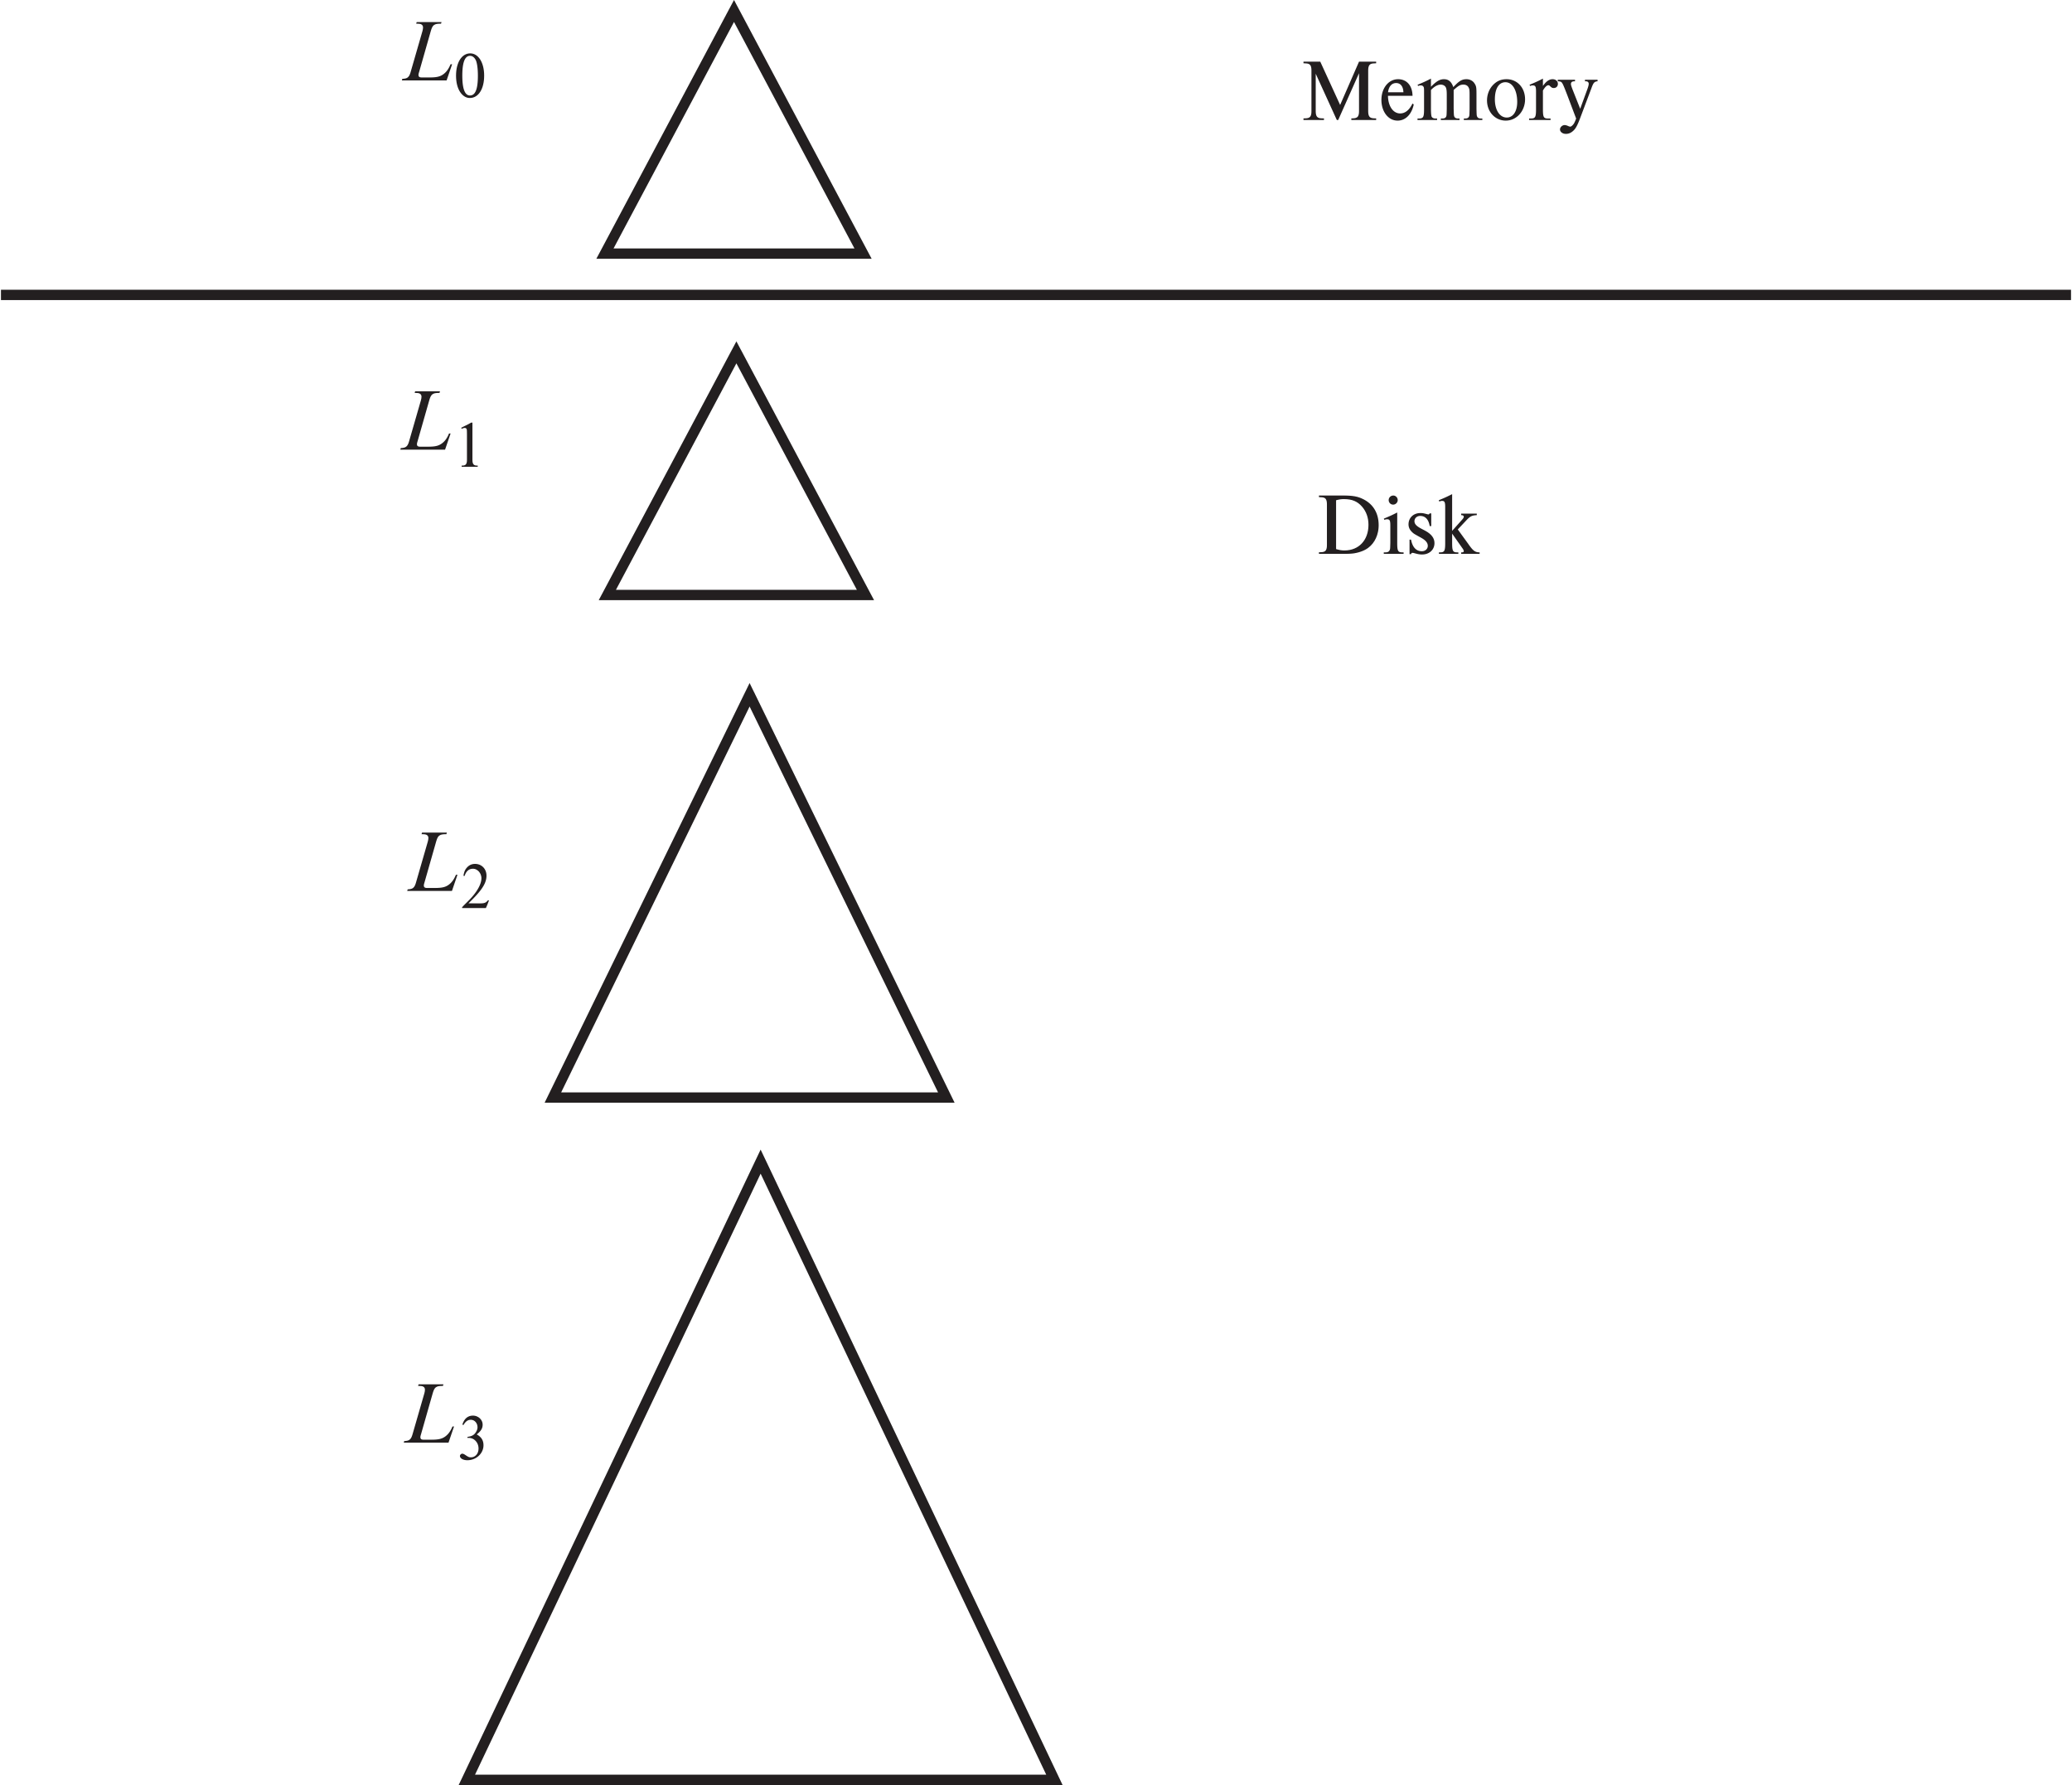
Log Structured Merge (LSM) Tree
Consider only inserts/queries for now
Records inserted first into in-memory tree (L₀ tree)
When in-memory tree is full, records moved to disk (L₁ tree)
B⁺-tree constructed using bottom-up build by merging existing L₁ tree with records from L₀ tree
When L₁ tree exceeds some threshold, merge into L₂ tree
And so on for more levels
Size threshold for L_{i+1} tree is k times size threshold for L_{i} tree

Slide 162
LSM Tree (Cont.)
Benefits of LSM approach
Inserts are done using only sequential I/O operations
Leaves are full, avoiding space wastage
Reduced number of I/O operations per record inserted as compared to normal B⁺-tree (up to some size)
Drawback of LSM approach
Queries have to search multiple trees
Entire content of each level copied multiple times
Stepped-merge index
Variant of LSM tree with multiple trees at each level
Reduces write cost compared to LSM tree
But queries are even more expensive
Bloom filters to avoid lookups in most trees
Details are covered in Chapter 24

Slide 163
LSM Trees (Cont.)
Deletion handled by adding special “delete” entries
Lookups will find both original entry and the delete entry, and must return only those entries that do not have matching delete entry
When trees are merged, if we find a delete entry matching an original entry, both are dropped.
Update handled using insert+delete
LSM trees were introduced for disk-based indices
But useful to minimize erases with flash-based indices
The stepped-merge variant of LSM trees is used in many BigData storage systems
Google BigTable, Apache Cassandra, MongoDB
And more recently in SQLite4, LevelDB, and MyRocks storage engine of MySQL

Slide 164
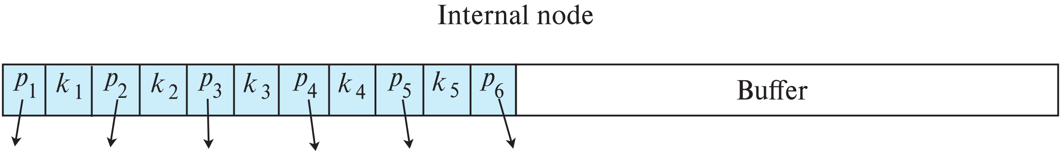
Buffer Tree
Alternative to LSM tree
Key idea: each internal node of B⁺-tree has a buffer to store inserts
Inserts are moved to lower levels when buffer is full
With a large buffer, many records are moved to lower level each time
Per record I/O decreases correspondingly
Benefits
Less overhead on queries
Can be used with any tree index structure
Used in PostgreSQL Generalized Search Tree (GiST) indices
Drawback: more random I/O than LSM tree

Slide 165
Bitmap Indices
Bitmap indices are a special type of index designed for efficient querying on multiple keys
Records in a relation are assumed to be numbered sequentially from, say, 0
Given a number n it must be easy to retrieve record n
Particularly easy if records are of fixed size
Applicable on attributes that take on a relatively small number of distinct values
E.g., gender, country, state, …
E.g., income-level (income broken up into a small number of levels such as 0-9999, 10000-19999, 20000-50000, 50000- infinity)
A bitmap is simply an array of bits

Slide 166
Bitmap Indices (Cont.)
In its simplest form a bitmap index on an attribute has a bitmap for each value of the attribute
Bitmap has as many bits as records
In a bitmap for value v, the bit for a record is 1 if the record has the value v for the attribute, and is 0 otherwise
Example

Slide 167
Bitmap Indices (Cont.)
Bitmap indices are useful for queries on multiple attributes
not particularly useful for single attribute queries
Queries are answered using bitmap operations
Intersection (and)
Union (or)
Each operation takes two bitmaps of the same size and applies the operation on corresponding bits to get the result bitmap
E.g., 100110 AND 110011 = 100010
100110 OR 110011 = 110111 NOT 100110 = 011001
Males with income level L1: 10010 AND 10100 = 10000
Can then retrieve required tuples.
Counting number of matching tuples is even faster

Slide 168
Bitmap Indices (Cont.)
Bitmap indices generally very small compared with relation size
E.g., if record is 100 bytes, space for a single bitmap is 1/800 of space used by relation.
If number of distinct attribute values is 8, bitmap is only 1% of relation size

Slide 169
Efficient Implementation of Bitmap Operations
Bitmaps are packed into words; a single word and (a basic CPU instruction) computes and of 32 or 64 bits at once
E.g., 1-million-bit maps can be and-ed with just 31,250 instruction
Counting number of 1s can be done fast by a trick:
Use each byte to index into a precomputed array of 256 elements each storing the count of 1s in the binary representation
Can use pairs of bytes to speed up further at a higher memory cost
Add up the retrieved counts
Bitmaps can be used instead of Tuple-ID lists at leaf levels of B⁺-trees, for values that have a large number of matching records
Worthwhile if > 1/64 of the records have that value, assuming a tuple-id is 64 bits
Above technique merges benefits of bitmap and B⁺-tree indices

Slide 170
Spatial and Temporal Indices

Slide 171
Spatial Data
Databases can store data types such as lines, polygons, in addition to raster images
allows relational databases to store and retrieve spatial information
Queries can use spatial conditions (e.g. contains or overlaps).
queries can mix spatial and nonspatial conditions
Nearest neighbor queries, given a point or an object, find the nearest object that satisfies given conditions.
Range queries deal with spatial regions. e.g., ask for objects that lie partially or fully inside a specified region.
Queries that compute intersections or unions of regions.
Spatial join of two spatial relations with the location playing the role of join attribute.

Slide 172
Indexing of Spatial Data
k-d tree - early structure used for indexing in multiple dimensions.
Each level of a k-d tree partitions the space into two.
Choose one dimension for partitioning at the root level of the tree.
Choose another dimensions for partitioning in nodes at the next level and so on, cycling through the dimensions.
In each node, approximately half of the points stored in the sub-tree fall on one side and half on the other.
Partitioning stops when a node has less than a given number of points.
The k-d-B tree extends the k-d tree to allow multiple child nodes for each internal node; well-suited for secondary storage.

Slide 173
Division of Space by Quadtrees
Each node of a quadtree is associated with a rectangular region of space; the top node is associated with the entire target space.
Each non-leaf nodes divides its region into four equal sized quadrants
correspondingly each such node has four child nodes corresponding to the four quadrants and so on
Leaf nodes have between zero and some fixed maximum number of points (set to 1 in example).

Slide 174
R-Trees
R-trees are a N-dimensional extension of B⁺-trees, useful for indexing sets of rectangles and other polygons.
Supported in many modern database systems, along with variants like R⁺ -trees and R*-trees.
Basic idea: generalize the notion of a one-dimensional interval associated with each B+ -tree node to an N-dimensional interval, that is, an N-dimensional rectangle.
Will consider only the two-dimensional case (N = 2)
generalization for N > 2 is straightforward, although R-trees work well only for relatively small N
The bounding box of a node is a minimum sized rectangle that contains all the rectangles/polygons associated with the node
Bounding boxes of children of a node are allowed to overlap

Slide 175
Example R-Tree
A set of rectangles (solid line) and the bounding boxes (dashed line) of the nodes of an R-tree for the rectangles.
The R-tree is shown on the right.

Slide 176
Search in R-Trees
To find data items intersecting a given query point/region, do the following, starting from the root node:
If the node is a leaf node, output the data items whose keys intersect the given query point/region.
Else, for each child of the current node whose bounding box intersects the query point/region, recursively search the child
Can be very inefficient in worst case since multiple paths may need to be searched, but works acceptably in practice.

Slide 177
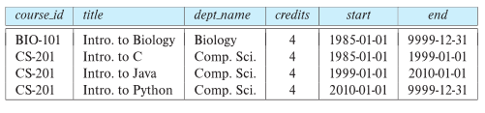
Indexing Temporal Data
Temporal data refers to data that has an associated time period (interval)
Example: a temporal version of the course relation
Time interval has a start and end time
End time set to infinity (or large date such as 9999-12-31) if a tuple is currently valid and its validity end time is not currently known
Query may ask for all tuples that are valid at a point in time or during a time interval
Index on valid time period speeds up this task

Slide 178
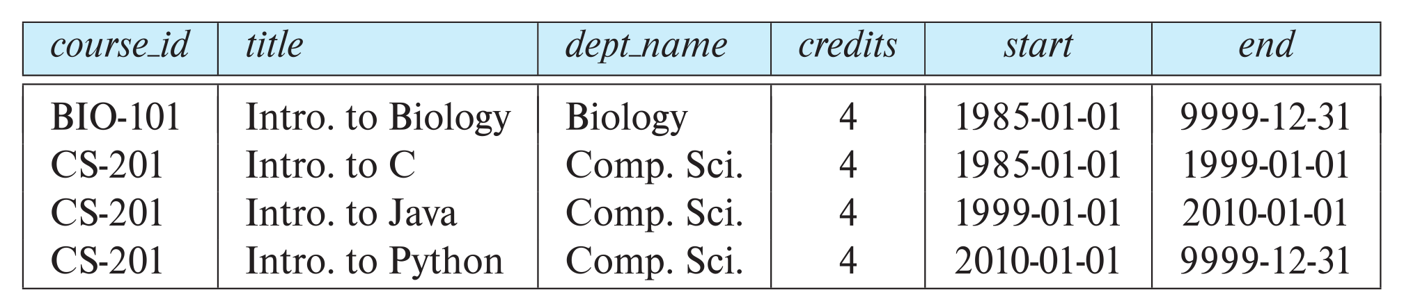
Indexing Temporal Data (Cont.)
To create a temporal index on attribute a:
Use spatial index, such as R-tree, with attribute a as one dimension, and time as another dimension
Valid time forms an interval in the time dimension
Tuples that are currently valid cause problems, since value is infinite or very large
Solution: store all current tuples (with end time as infinity) in a separate index, indexed on (a, start-time)
To find tuples valid at a point in time t in the current tuple index, search for tuples in the range (a, 0) to (a,t)
Temporal index on primary key can help enforce temporal primary key constraint

